Slide 1
Clinical Teaching
Made Easy (or Easier)
Evidence-Based Strategies
for Busy Clinical Faculty
RADHA M. DENMARK, MSN, FNP-C
UNIVERSITY OF NEW MEXICO
radenmark@salud.unm.edu
Notes:
Radha Denmark is a family nurse practitioner and the Director of Advanced Practice Education and Professional Development at UNM Hospital, where she’s worked for the last 16 years. She completed a Bachelor of Science in Nursing from the University of New Mexico in 2007 and then a Master of Science in Nursing from Frontier Nursing University in Kentucky in 2012. She is happily nearing completion of her Doctorate in Nursing Practice. Radha has lectured nationally in recent years on her favorite topics: APP transition to practice, preceptor development, and remediation. She also loves to garden, run, lift weights, and spend time with her amazing family.
Thank you... Let’s jump into the talk about professional development for clinical faculty!

Slide 2
Learning Outcomes
Use
a pre-clinical orientation checklist to prepare APRN/PA learners for their clinical experience
Apply
the RIME framework to assess and promote APRN/PA development of clinical practice skills
Describe
the deliberate practice model for acquisition of expertise and a feedback method that goes with it
Apply
the One-Minute Preceptor teaching technique to a clinical scenario
Notes:
After this session, I hope you’ll walk away with ideas for creation of a clinical orientation checklist, a new framework for evaluating APRN/PA learners, a feedback method that promotes psychological safety and learning, and an improved understanding of how the one-minute preceptor technique can save time and promote learning.

Slide 3
I have no disclosures.

Slide 4
Postgraduate APP training programs require the skills of clinical preceptors to train the next generation of APPs.
Notes:
As we all know, postgraduate APP training programs require the service of skilled clinical preceptors to train the next generation of APPs.

Slide 5
Most APPs have not completed formal training as clinical educators.
Notes:
The cornerstone of APP postgraduate education is participation in real world clinical experiences under the guidance of a clinical educator. But many APPs receive no formal training on how to teach APP learners and instead rely on their past experiences with their own preceptors as a guide for how to precept. Or they teach in a manner consistent with how they prefer to learn.
(Wiseman, 2013)

Slide 6
Challenges to precepting include time constraints, workload, and longer clinical days.
Notes:
In addition, teaching in the clinical setting is challenging due to time constraints, a patient workload that is not decreased when there is a learner present, and longer clinical days when the preceptor inevitably runs behind.

Slide 7
Preceptors need evidence-based teaching strategies that are efficient, impactful, and simple to use!
Notes:
These conditions may lead to preceptors being unwilling to take on students, or if they do, they can contribute to burnout. We need to provide our preceptors with evidence-based teaching strategies that are efficient, impactful, and simple to use!

Slide 8
Orientation to Clinical Site
RIME Method of Evaluation
Feedback with Good Judgment
The 1-Minute Preceptor
(Fincham et al, 2019)
Notes:
So, where are we going? This is not an existential question. This is my outline! In an article published by Fincham and colleagues in 2019, the authors describe the results of a literature review conducted to identify evidence-based and time-efficient strategies for preceptors. Their review identified four best practices which I'll elaborate on in this talk. I'll also briefly share an expanded preceptor training that will be offered to you and your clinical faculty later in the year. The best practices we'll discuss will include an orientation checklist, the RIME evaluation method, the feedback with good judgment method, and the one-minute preceptor teaching strategy.

Slide 9
Create and review orientation expectations to decrease learner anxiety and improve performance.
Dress code
Charting expectations
Contact information
Clinical practice routines
Patient population
Teaching/feedback style
Clinical expectations
Notes:
I coordinate APRN/PA student clinical placement at UNM and oversee the postgraduate fellowship programs. I encourage preceptors to meet with their students ahead of time to orient them to the essential details and the preceptor's expectations and clinic workflow. We do this in our APP fellowships as well, in the form of written orientation guides for each clinical rotation. The clinical coordinator, preceptor, and APP fellow are expected to meet before the rotation occurs to convey expectations and provide an opportunity to ask questions away from the busy clinical environment.

Slide 10
Notes:
Learners need to know where to go on their first day, what to bring and what to wear, and how to reach out to you urgently if they are sick. Providing them with a clear picture of what their clinical experience will look like decreases anxiety which can improve performance. They should know that they are expected to write notes and have an example of the template you want them to follow. Summarize your clinical workflow, the type of patients you see, and the most frequent diagnoses they should study ahead of time. Tell them how busy the clinical setting is and the time constraints you have to work within. This includes letting them know what format they should present in, how long they have to do that, how much time is to be spent with patients, and what parts of the encounter they should focus on. Talk about your teaching and feedback style upfront. This has been shown to improve students' ability to receive feedback and their perception of the feedback.
(Wilson, 2013 in Fincham et al., 2019).

Slide 11
Evidence-Based Evaluation
THE RIME METHOD
Notes:
So now you’ve reflected on and shared your expectations with your learner, and you’re ready to start evaluating them. You may have previously heard me speak about Benner’s Novice to Expert model of knowledge acquisition. Today we’re going to focus on the Reporter-Interpreter-Manager-Educator developmental framework initially presented by Dr. Louis Pangaro in the 1990s. RIME is a validated and reliable developmental framework for clinical teaching and evaluation.

Slide 12
Learners, like plants, grow and thrive over time when given the right care.
Notes:
It's hard to give feedback. Many preceptors teach as they were taught or default to qualitative descriptions such as "You did a great job!" or "Wow, you struggled a little with that, huh?" Like plants grow and thrive over time, so do our learners, when given the right attention and care.

Slide 13
RIME is a developmental framework for clinical teaching and evaluation.
Notes:
RIME is a developmental framework for clinical teaching and evaluation. Each level within the framework requires learners to synthesize knowledge, skills, and attitudes as they progress from novice to expert. Direct observation allows the preceptor to identify the learner at one of the four stages (Reporter, Interpreter, Manager, or Educator). They can then provide targeted feedback to help the student achieve competence in the areas needed to advance.
(Dewitt, Carline, Paauw, & Pangaro, 2008)
(Tolsgaard et al., 2012)
in Fincham et al. (2019)

Slide 14
Reporters gather, communicate, distinguish, and focus on central issues.
Notes:
The Reporter stage hones the learner's ability to perform an interview and appropriate physical exam and then communicate findings while demonstrating effective interpersonal skills. These attributes are necessary to build a foundation for clinical practice and should ideally be mastered before focusing on more complex skills. A learner in the reporter stage can reliably and accurately gather information, communicate clearly, distinguish important from unimportant information, and focus data collection and presentation on central issues. Reporters know what's essential and what's not.

Slide 15
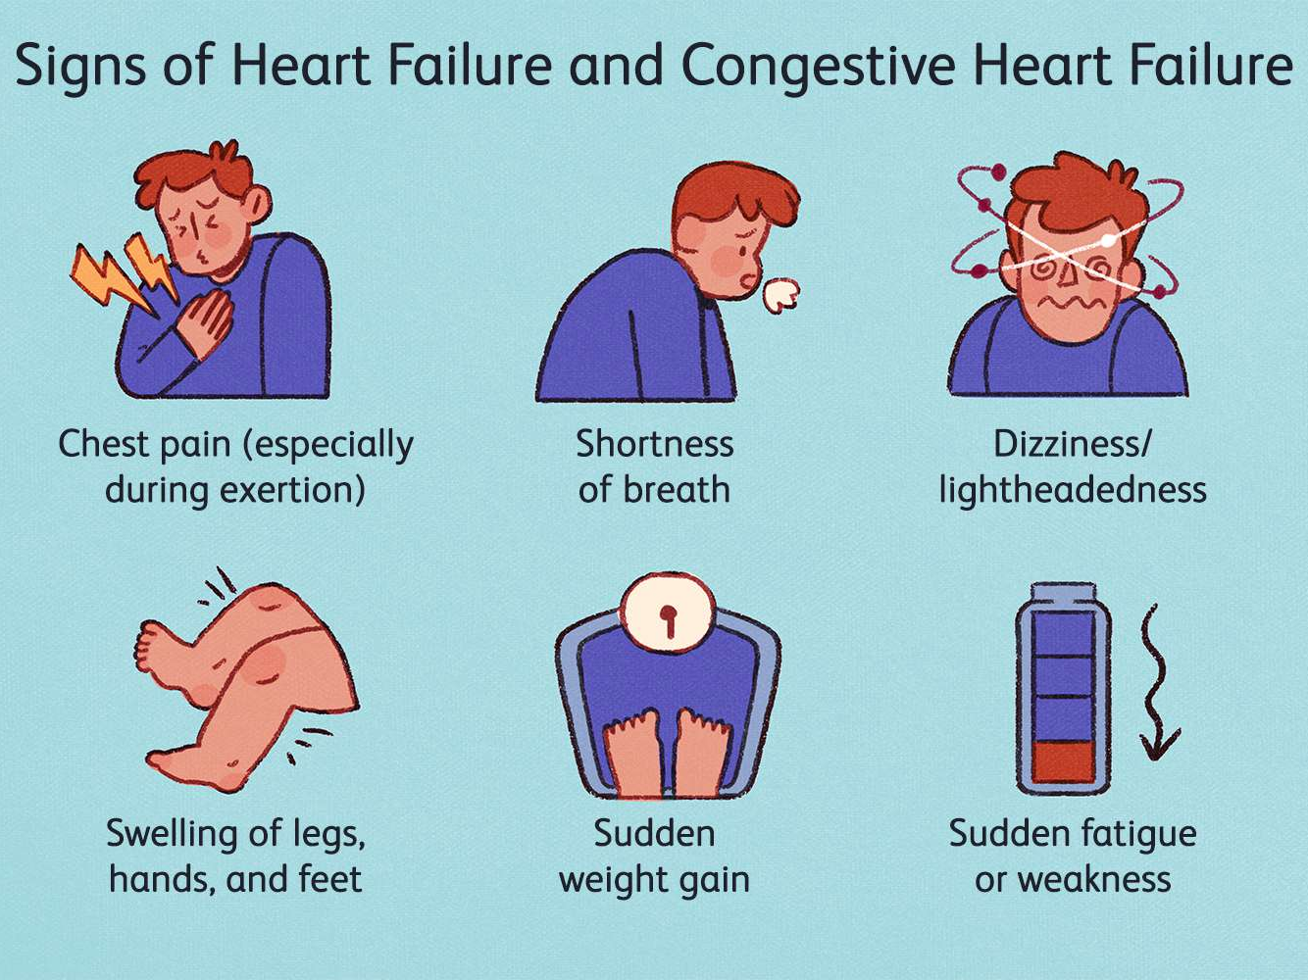
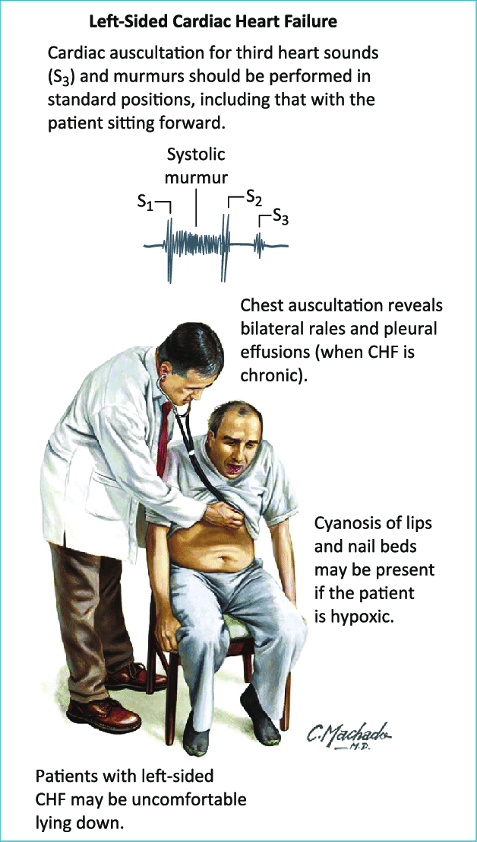
Notes:
For example, in a heart failure patient, a Reporter understands the central problem of SOB and leg swelling, asks about specific cardiopulmonary signs and symptoms in the history, and performs a thorough cardiopulmonary exam.

Slide 16
Interpreters analyze data and develop a DDx with rationale.
Notes:
Interpreters work on analyzing data (from the history, physical examination, and diagnostic studies) and learn how to use it to develop a differential diagnosis and determine the next steps as part of the workup. In addition to the Reporter's skills, Interpreters can independently identify and prioritize problems and develop and defend a prioritized differential diagnosis with solid rationale.

Slide 17
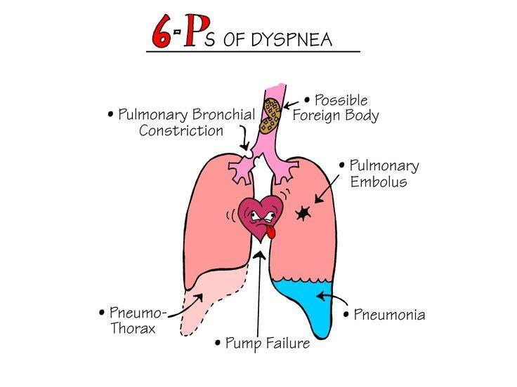
Notes:
For example, in a patient presenting with SOB and leg swelling, the Interpreter knows the differential diagnosis includes pulmonary embolism, pneumonia, and heart failure. Therefore, they ask targeted questions in the HPI and ROS about key and identifying features for all these conditions. They also tailor the physical exam to search for key and identifying features. In this way, they can determine what clinical syndrome best matches the patient’s individual presentation.

Slide 18
Managers develop and refine plans, decide, and individualize.
Notes:
In the next stage, Managers learn to incorporate patient preferences when developing reasonable treatment options, and they know how to navigate the complex healthcare system. Managers independently develop diagnostic and treatment plans, decide when action should be taken, and weigh the risk and benefits of diagnostic and treatment decisions to specific patient circumstances.

Slide 19
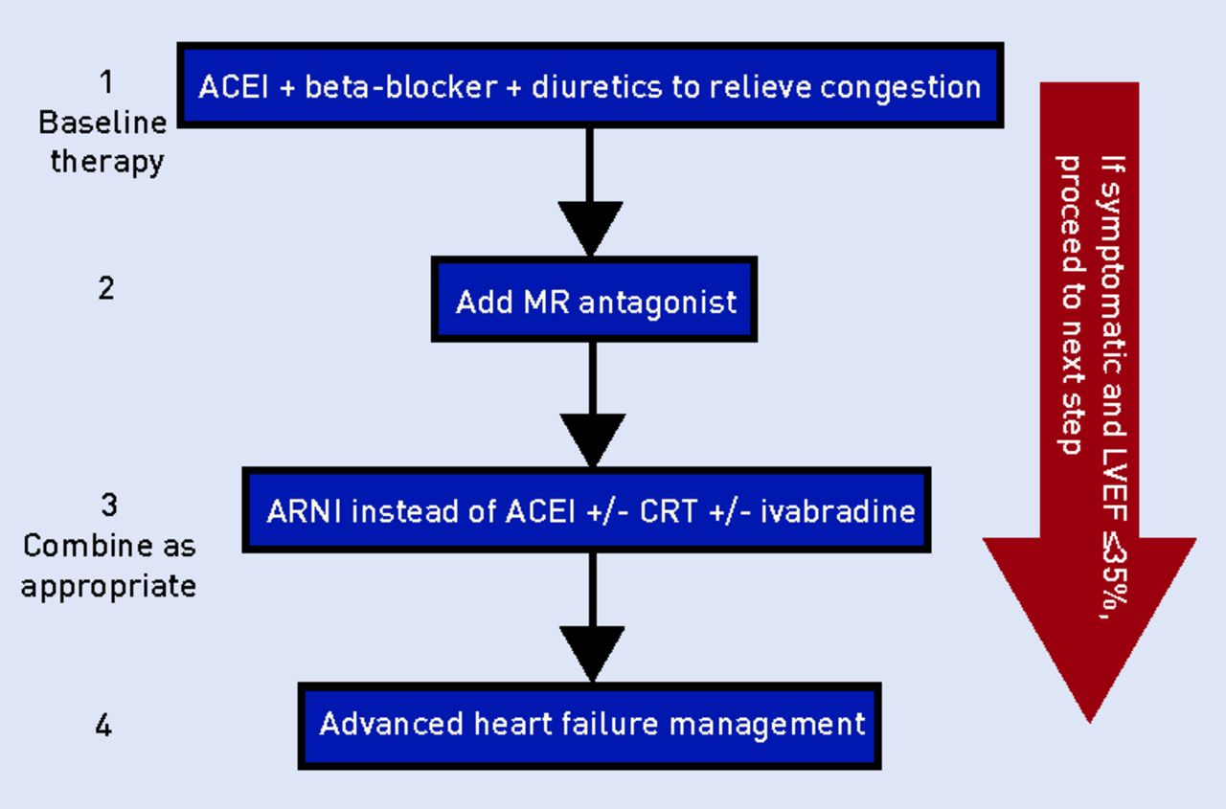
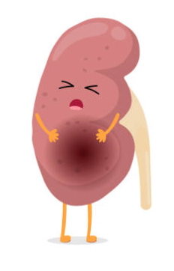
Notes:
For example, in a patient with heart failure, a Manager understands whether afterload reduction is indicated and if diuresis needs to happen. And if the patient has CKD, they know how different measures might need to be taken and how that affects their plan.

Slide 20
Educators define questions, seek and scrutinize evidence, and educate.
Notes:
Finally, Educators recognize their own learning needs. They know how to seek current scientific evidence to inform clinical practice decisions. Educators identify important clinical questions to seek evidence that informs their clinical practice. They have the skills to scrutinize the quality of the evidence and can educate the rest of the team on their findings.

Slide 21
Reporters & Interpreters
Managers
Educators
Notes:
We hope APRN/PA students learn to be proficient reporters and interpreters during their early clinical training. We want them to progress to competent managers by the time they graduate from their academic programs. Likewise, we hope our APRN/PA fellows and residents demonstrate proficiency as Educators by the time they complete our programs. Written fellow or resident evaluations may look different from the RIME framework, but we must understand what stage our learners are at so we can target feedback and teaching to help them level up.

Slide 22
Evidence-Based Feedback
WITH GOOD JUDGMENT
Notes:
So now that we know how to evaluate where our learners are on the competency spectrum, how do we ensure that we’re delivering feedback in the most effective way?

Slide 23
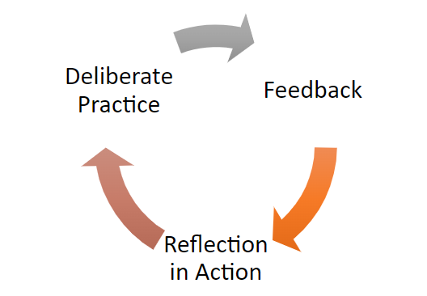
Deliberate Practice is a model for the acquisition of expertise.
(Ericsson, 2004)
Notes:
Well it starts with the conceptual model of deliberate practice. We’ve all heard of the 10,000 hour rule; that if you invest 10,000 hours into learning a new skill, you’ll achieve expertise in that skill. But the truth is, practice without feedback does not lead to expertise. That’s where deliberate practice comes in. Defined by the psychologist Anders Ericsson and colleagues, deliberate practice is “the individualized training activities specially designed by a coach or teacher to improve specific aspects of an individual's performance through repetition and successive refinement.” It’s a collaborative process that requires a learner’s commitment to receive and reflect on feedback from an expert. It also requires the expert, in this case the preceptor, to commitment to delivering critical feedback in an emotionally safe manner.

Slide 24
Notes:
Philosophically speaking, there’s no such thing as nonjudgmental feedback. We are human beings, observing and judging others on their clinical performance. The best we can hope for is to deliver feedback with good judgment. This approach draws on 35 years of behavioral sciences research on improving professional effectiveness through “reflective practice.” This approach encourages rigorous self-reflection that helps trainees recognize gaps in knowledge or unprofessional behavior and improve. However, before discussing the steps in this approach, we have to discuss two core concepts.

Slide 25
Feedback with good judgment requires preceptors to hold learners to high standards while holding them in high regard.
(Rudolph et al., 2006)
Notes:
First, Feedback with Good Judgment requires preceptors to hold learners to high standards while holding them in high regard. On the part of the educator, this is an internal shift in how they view the learner when they make a mistake or omission. To hold the learner in high regard is to generously view them as intelligent, capable individuals who have a unique point of view, care about doing their best, and want to get better. Of course, this high regard assumes the learner can meet the standard with the proper support.

Slide 26
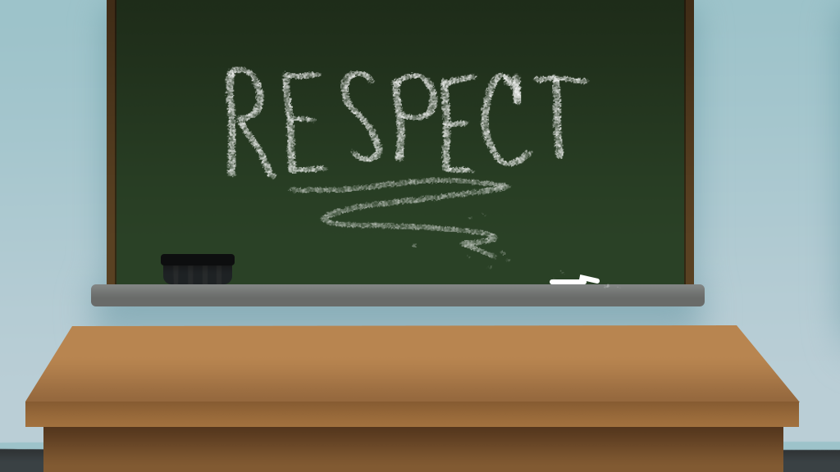
Notes:
When the preceptor genuinely assumes the best of the learner. it frees them from the work of hiding negative feelings. Even temporarily assuming the best of the learner allows the preceptor to take a curious and respectful stance toward the learner, which in turn allows them to share their expert judgment, even when critical, to encourage self-reflection and improvement. When learners consistently experience this high regard and genuine curiosity, it reduces their fear that mistakes and struggles will be met with shaming or humiliation.

Slide 27
Notes:
This is also known as psychological safety, or the belief that you won’t be punished or humiliated for speaking up with ideas, questions, concerns, or mistakes.
(Fey et al., 2022)

Slide 28
Feedback with good judgment also requires the preceptor to practice transparent thinking.
(Rudolph et al., 2006)
Notes:
Feedback with good judgment also requires the preceptor to practice transparent thinking. With this approach, preceptors share concrete observations about the learners’ performance and explicitly share what they believe the impact of that performance could be.

Slide 29
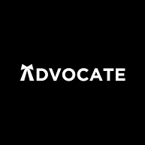
Feedback with good judgment begins with the preceptor’s observation, followed by an advocacy statement of the preceptor’s perspective and concern, and then an inquiry statement about the learner’s perspective and concern.
Notes:
Feedback with Good Judgment begins with the preceptor’s observation, followed by an advocacy statement of the preceptor’s perspective and concern, and then an inquiry statement about the learner’s perspective and concern.

Slide 30
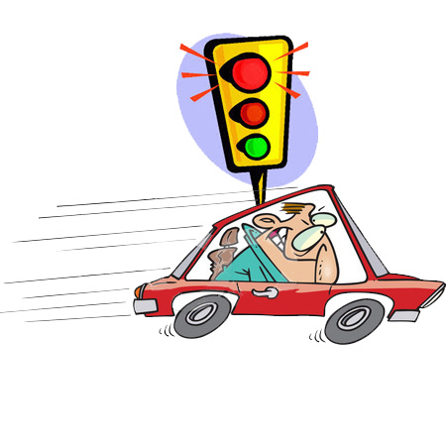
Observing the learner’s behavior is the first step in providing good feedback.
“I noticed you drove through a red light.”
Notes:
Observing the learner’s behavior is the first step in providing good feedback. First, you state, in a non-judgmental manner, what you observed the learner do. Be aware of and try to avoid assumptions that may influence your observations. All assumptions may be helpful, but they can also be misleading; therefore, stick to discussion of specific observable behaviors. For example, “I noticed you drove through a red light,” not, “Why on earth did you just blast through that red light?”

Slide 31
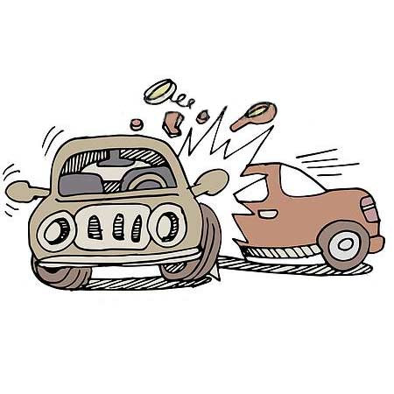
Second, the preceptor makes an advocacy statement that describes their perspective and concern about the observation.
“That worries me because running red lights increases the risk that you’ll be involved in a serious car accident that could hurt you or someone else.”
Notes:
Second, the preceptor makes an advocacy statement that describes their perspective and concern about the observation. Preceptors are advocates for best practices in their field. If they observe a practice that is exemplary OR off base, then they need to provide feedback that advocates to continue the good practice OR explain what the typical practice consists of. The advocacy statements exposes the preceptors frame, their point-of-view. For example, “I noticed you drove through a red light, and that worries me because running red lights increases the risk that you’ll be involved in a serious car accident that could hurt you or someone else.”

Slide 32
The third and final step is an inquiry statement seeking the learner’s perspective and concern.
Notes:
The third and final step is an inquiry statement seeking the learner’s perspective and concern. This is the essential step that purposely exposes the learner’s frame so that a non-threatening conversation focused on improvement takes place. Inquiry simply involves asking about why the learner did things a certain way.

Slide 33
Inquire
Observe
Advocate
Notes:
For example, “I noticed that you drove through a red light, and that worries me because running red lights increases the risk that you’ll be involved in a serious car accident that could hurt you or someone else. Can you tell me what was going on for you at that time? ”

Slide 34
Video: Providing Feedback with Good Judgment
Notes:
But of course, we’re talking about giving feedback to learners in the medical setting, not in driving school. So here’s a two minute video demonstrating the use of Feedback with Good Judgment in the clinical setting. Remember the core elements required for this method to be effective: A belief that all Learners are intelligent, have a unique point of view, and care about doing their best, and a willingness to engage in transparent thinking so that both the perspectives of the preceptor and the learner can occur and facilitate learning.

Slide 35
Feedback Pearls
Timely feedback
Limit to 1-2 key points
Use discretion
Notes:
I hope you found that example helpful in understanding the Observer-Advocate-Inquirer components of Feedback with Good Judgment. Here are a couple more pearls to wrap this up. First (CLICK), for the most effective learning to take place, you should deliver feedback routinely, and at the time of the experience or immediately after. Next (CLICK), for the greatest impact, you should also limit feedback to just one or two key points and provide opportunity for two-way communication. Finally, (CLICK) to promote a sense of psychological safety and decrease fear around being wrong or making mistakes, negative feedback should be provided in private and not in front of patients, families, or other staff.
(Thomas & Arnold, 2011)
(Cantillon & Sergeant, 2008)
(Barker & Pittman, 2010)

Slide 36
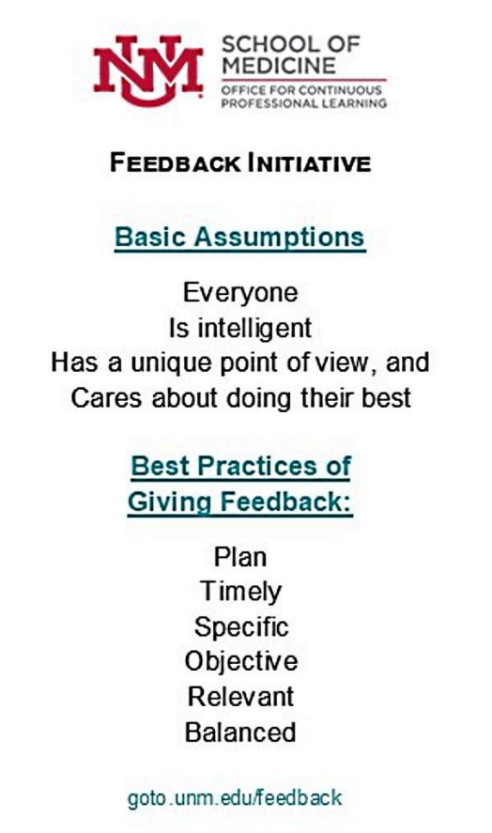
Notes:
I’ve include a slide with phrases to prompt your practice and a link to UNM’s Feedback Initiative website.

Slide 37
Evidence-Based Clinical Teaching
THE ONE-MINUTE PRECEPTOR
Notes:
Lastly, let’s touch briefly on one evidence-based clinical teaching method that randomized-controlled trials have consistently demonstrated to be effective and time-saving.

Slide 38
The OMP allows for expeditious teaching in the busy clinical environment.
Notes:
Most of us have heard about the one-minute preceptor, but only some use it in practice. The OMP is an efficient tool for clinical teaching that focuses on using five micro-skills, allowing expeditious teaching in the busy clinical environment. Despite its name, the OMP takes more than one minute to use (it's closer to five minutes, in my experience) but remains an efficient tool for clinical teaching. This method allows you to understand the facts of the case and evaluate the learner's decision-making process. You reinforce positive behaviors, correct mistakes, and fill in knowledge gaps by providing targeted teaching points.
(Barker & Pittman, 2010)
(Farrell, Hopson, Wolff, Hemphill, & Santen, 2016)
(Neher et al., 1992).

Slide 39
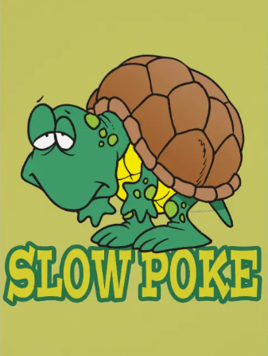
Having a student can really
slow you down.
Notes:
Having a student can really slow you down. They can take forever to present cases to you. While case presentation is an important part of clinical training, it is a skill that should be learned prior to the first clinical day. It may be a skill you want to test and repeat for improvement, but not for every patient. I recommend skipping over the formal presentation most of the time and just get to the good stuff… the clinical teaching!

Slide 40
First, get a commitment from the learner.
“What do you think is going on with this patient?”
Notes:
First, get a commitment (or like Beyonce advised, “Put a ring on it!”). Ask “what do you think is going on with this patient?” or “What do you think we should do for this patient?” It’s okay if they’re wrong. The point is, they need to get used to making a decision and backing it up.

Slide 41
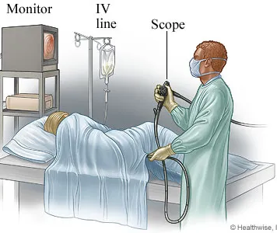
Second, probe for supporting evidence.
“So tell me why heart failure is the right diagnosis?”
Notes:
Second, probe for supporting evidence. Not this kind of probe of course. Have them explain their reasoning. “So share with me why you feel heart failure is the right diagnosis?” If they got the right diagnosis you want to be sure they got there the right way. And if they got it wrong, you want to know where they went wrong along the way. Focus on the important things, such as positive findings and relevant negatives.

Slide 42
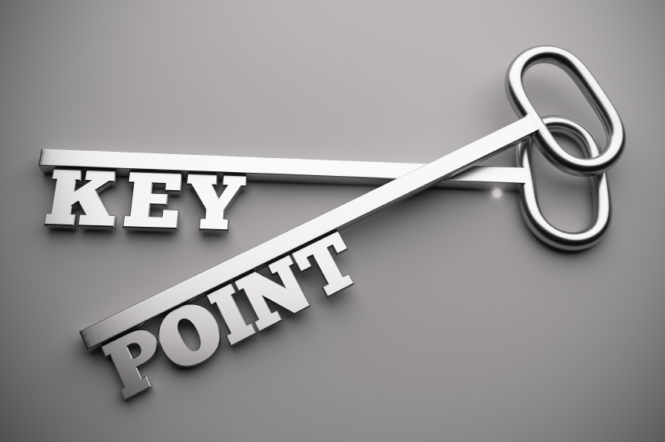
Third, teach a short, general principle.
“A general rule relevant to this case is…”
Notes:
For each case you see with the student, given them one pearl, a general point that applies to most cases, “A general rule relevant to this case is that heart failure patients with an ejection fraction of 40% or less should ideally be on an ACE inhibitor due to the reduction of mortality benefit.” Get them to make notes. At the end of the clinic you can sit down to review the things they learned (at least one thing for each patient). This can help them identify topics for studying at home later on.

Slide 43
Fourth, reinforce what was done well. Pick one thing the learner did right and let them know they should keep doing it!
“Great summary. You did a thorough job eliciting key history from this patient.”
Notes:
Fourth, reinforce what was done well. Pick one or two things the learner did right and let them know they did well and should keep doing it! “Great summary. You did a thorough job eliciting key history from this patient.”

Slide 44
Fifth, and finally, give guidance on an error or an omission. Pick ONE and move on to the next patient.
“Next time, I would encourage you to…”
Notes:
Fifth, and finally, give guidance on an error or an omission. Pick ONE and move on to the next patient. “Next time, I would encourage you to look back in the chart to see when the patient’s most recent echocardiogram and ejection fraction was.”

Slide 45
Notes:
Here are all those skills in one place. This process takes practice, but once you have it down, it will save you time and make you a more efficient and effective preceptor.

Slide 46
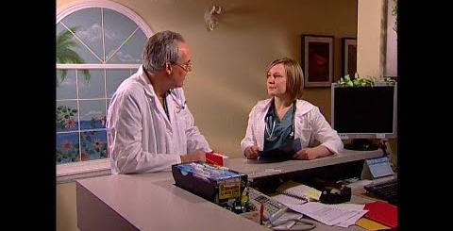
https://youtu.be/a3qiyniSaNg
Notes:
Here’s a two minute demonstration of the OMP. (PLAY) Thinking back to what we learned about RIME evaluation, notice that the learner has solid reporting skills, and has received focused teaching that will help her grow as an interpreter and manager.

Slide 47
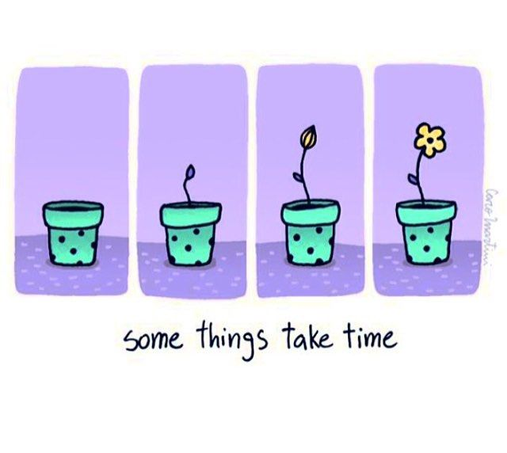
Preceptors need to learn concise and simple skills to orient, evaluate, give feedback, and teach the next generation of APRN/PAs.
Notes:
We’ve reached the end of our time together today. My take-home message is that we as preceptors need to learn concise and straightforward skills to orient, evaluate, give feedback, and teach the next generation of APRNs/PAs. But these skills are hard to introduce in an hour, let alone practice and develop mastery.

Slide 48
Preceptor Training Program
Orienting the postgraduate trainee
Evaluating the postgraduate trainee
Feedback, psychological safety, and deliberate practice
Evidence-based precepting methods
Time management and efficiency
Challenging learners (both ends of the spectrum)
Notes:
In recognition of this fact, I’m happy to report that I am working on a series of workshops for you and your preceptors to learn and practice these skills that I’ve introduced today. These are the planned topics: Orienting the postgraduate trainee with anticipatory expectations, evaluating with the RIME method, providing safe and effective feedback that engages the learner and preceptor as a team, evidence-based precepting methods such as the OMP that save time and helps learners grow, key time management and efficiency skills for clinical teaching, and addressing challenging learners on both ends of the spectrum (struggling and exceptional). I’m looking forward to sharing more in the coming year!

Slide 49
References
Emory Department of Medicine. (2018, Apr 13). Teaching evaluations: The RIME method [Video]. YouTube. https://youtu.be/YlPa9hrX1bo
Ericsson, K. A. (2004),. Deliberate practice and the acquisition and maintenance of expert performance in medicine and related domains. Academic Medicine, 79(10), S70-S81. https://journals.lww.com/academicmedicine/pages/articleviewer.aspx?year=2004&issue=10001&article=00022&type=Fulltext
Fey, M. K., Roussin, C. J., Rudolph, J. W., Morse, K. J., Palaganas, J. C., & Szyld, D. (2022). Teaching, coaching, or debriefing with good judgment: A roadmap for implementing “with good judgment" across the simzones. Advances in Simulation, 7(1), 39. https://doi.org/10.1186/s41077-022-00235-y
Fincham, S. J., Smith, T., & Purath, J. (2019). Implementation of an educational program to improve precepting skills. Journal of the American Association of Nurse Practitioners, 33(4), 331–337. https://doi.org/10.1097/JXX.0000000000000326
Pitts, C., Padden, D., Knestrick, J., & Bigley, M. B. (2019). A checklist for faculty and preceptor to enhance the nurse practitioner student clinical experience. Journal of the American Association of Nurse Practitioners, 31(10), 591–597. https://doi-org.libproxy.unm.edu/10.1097/JXX.0000000000000310
RhPAP. (2019, Jul 29). One minute preceptor [Video]. YouTube. https://youtu.be/a3qiyniSaNg
Rudolph, J. W., Simon, R., Dufresne, R. L., & Raemer, D. B. (2006). Thereʼs no such thing as “nonjudgmental” debriefing: a theory and method for debriefing with good judgment. Simulation in Healthcare: The Journal of the Society for Simulation in Healthcare, 1(1), 49–55.
Sentio University. (2021). What is deliberate practice? https://sentio.org/what-is-deliberate-practice#:~:text=Defined%20by%20the%20psychologist%20Anders,%26%20Lehmann%2C%201996%2C%20pp.
Surgery 101. (2716, Aug 17). LEGO surgery: One minute preceptor. [Video]. YouTube. https://youtu.be/k1owPOJ1e1k
University of New Mexico. (n.d.). Feedback with good judgment. https://hsc.unm.edu/medicine/education/cpl/_cpl-media/mini-jitl-resources/feedback/#/
Notes:
Here are my references, including links to the videos I shared and a few articles and other resources.

