Slide 1
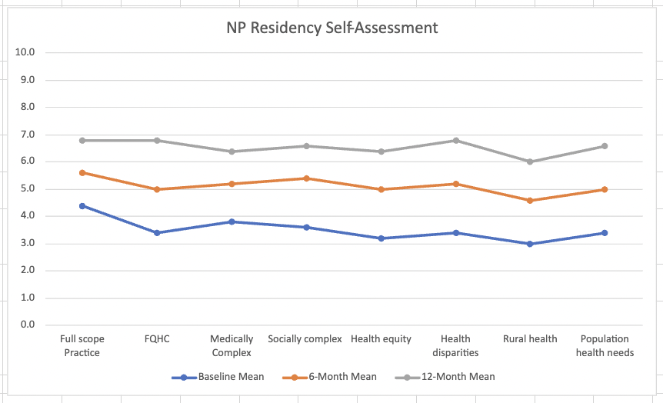
Academic Institution-Based NP Residencies Increase Access to Care for Vulnerable Populations
Holmes, L.R., Hultquist, T., Stoltman, A., & Fiandt, K.
University of Nebraska Medical Center, College of Nursing, Omaha NE
NP residencies have been evaluated in the literature for their generally positive impact on transition to practice, despite some nurse practitioner organizations questioning their necessity. Apart from providing transition to practice, academic institution-based residencies, compared with healthcare organization-based residencies may provide distinct benefits to the resident and to community partners.
Academic institutions often have strong community relationships with a variety of clinical organizations. By selectively engaging with clinical partners who focus on care of underrepresented communities, academic institution-based residencies can effectively bring newly graduated NPs to rural and vulnerable communities. The NP residency then provides training, skills and mentorship needed to care for high need high-cost patients leading to increased confidence and decreased turnover of the NPs working in these communities.
SSel
Future Directions
Background/Introduction
Results
Discussion / Conclusion
Selected Lit Review
Academic institution-based NP residencies allow for the recruitment of both clinical settings and residents. Therefore, clinical settings can be thoughtfully engaged to participate in the residency, increasing NP hiring in practices serving underrepresented, rural, or high need, high-risk patients. Additionally, these residents can be initially matched with a specific clinical setting and then further developed with the specific knowledge, skills, and abilities (KSA) to meet the needs of that population. The residents report more confidence in working with these patient groups and are generally retained for hire in these clinics. This process allows for increased access to care for vulnerable populations and increased opportunities for newly graduated NPs seeking to work with these populations.
Most of the research on postgraduate residency programs examines the impact on the provider and less is known about the workforce development and patient care benefits of nurse practitioner residencies (Nicely, 2015). However, the demand for primary care providers, particularly in primary care areas including rural and underserved communities is only expected to increase (Beurhaus, 2017). One study did note residency results showing improved recruitment and retention of new graduate NPs in primary care which can include those recruited by the residency program to complete the residency and stay in rural and underserved community clinics. (Matsolf et al., 2017).
Met with clinical partners prior to grant application to gauge interest
MOUs with primary care assn. and individual FQHCs
Grant received
Development year
Met again with HCAN and individual FQHCs to confirm placements
Stakeholder meetings to inform didactic content
Resident recruitment specific to sites
Engaging Community Stakeholders Who Serve Vulnerable Populations
Compare academic institution-based with healthcare organization-based NP residency programs and their individual impacts on both newly graduated NPs and the communities where they practice
Assess one new midwestern academic institution-based NP residency’s impact on workforce development in underrepresented communities.
Objective/Purpose
Resident Knowledge Confidence r/t Underserved Community Issues
This study was done with a very small sample in one academic
institution-based NP residency. Continued evaluation with additional cohorts of residents would provide a correlation of outcomes. Additional academic institution-based NP residency programs in other areas of the country would also enhance findings. Comparing outcomes, particularly workforce development outcomes working with high need and vulnerable populations, with community health center-based NP residencies or other types of NP residencies would also be valuable.
Methods
Literature review
Staff interview
Review of clinical mentor and resident evaluations
References
American Association of Nurse Practitioners . (n.d.). The Nurse Practitioner Roundtable Position on Postgraduate Clinical Training. American Association of Nurse Practitioners. Retrieved June 29, 2022, from https://www.aanp.org/advocacy/advocacy-resource/aanp-and-the-np-roundtable-joint-statements
Buerhaus, P., Skinner, L., Auerbach, D., & Staiger, D. (2017). Four challenges facing the nursing workforce in the United States Journal of Nursing Regulation,8,40–46
Flinter, M. M., & Bamrick, K. (2017). Training the next generation: Residency and fellowship programs for Nurse Practitioners in community health centers. Community Health Center, Inc., and the Weitzman Institute.
Hart, A. M., & Bowen, A. (2016). New nurse practitioners’ perceptions of preparedness for and transition into practice. The Journal for Nurse Practitioners, 12(8), 545–552. https://doi.org/10.1016/j.nurpra.2016.04.018
IOM Future of Nursing Report. ANA. (n.d.). Retrieved June 29, 2022, from https://www.nursingworld.org/practice-policy/iom-future-of-nursing-report/
Kesten, K. S., & El-Banna, M. M. (2020). Facilitators, barriers, benefits, and funding to implement postgraduate nurse practitioner residency/fellowship programs. Journal of the American Association of Nurse Practitioners. https://doi.org/10.1097/jxx.0000000000000412.
Kaplan, L., Pollack, S. W., Skillman, S. M., & Patterson, D. G. (2020). NP program efforts promoting transition to rural practice. The Nurse Practitioner, 45(10), 48–55. https://doi.org/10.1097/01.npr.0000696920.66207.65
Martsolf, Grant R. et al. What We Know About Postgraduate Nurse Practitioner Residency and Fellowship Programs.The Journal for Nurse Practitioners, 13, Issue 7, 482 – 487
Wiltse Nicely, K. L., & Fairman, J. (2015). Postgraduate nurse practitioner residency programs. Academic Medicine, 90(6), 707–709. https://doi.org/10.1097/acm.0000000000000567
Sample
Cohort 1 of HRSA ANE-NPR
First NP residency program in Nebraska
5 post-graduate nurse practitioners
4 MSN degrees
1 DNP degree
4 Family specialty
1 Adult Primary Care specialty

