Slide 1
November 2022 Web Café Reducing Provider Burnout in a Learning Environment
Surani Hayre-Kwan, DNP, MBA, FNP-BC, FACHE, FAANP Director, Professional Practice & Nursing Excellence Sutter Health
1

Slide 2
Get the Most Out of Your Zoom Experience
Use the Q&A Button to submit questions during today’s session
Use the chat feature to submit technical questions.
Recording and presentations will be made available to everyone after the session at 2022 Annual Consortium Conference Resources (nppostgradtraining.com)
Unanswered questions will be responded following the webinar and posted to the webpage
Notes:
.
Kerry

Slide 3
Provider Burnout in the Learning Environment
Surani Hayre-Kwan, DNP, MBA, FNP-BC, FACHE, FAANP
Samuel Merritt University ~ Adjunct Assistant Professor
Sutter Health ~ Director, Professional Practice & Nursing Excellence

Slide 4
“Who is prone to burnout?
The dedicated and the committed.”
- Herbert Freudenberger
Notes:
NP residents are dedicated and committed – this is evident in their decision to participate in a residency program
We need to bolster their well-being during this transition to full practice

Slide 5
exhaustion
inefficacy
cynicism
BURNOUT
Notes:
We are familiar with this model of burnout
Caused by external factors that lead to this combination
It is a terrible way to feel
No one gets here overnight
There are predictable stages of burnout leading up to this result

Slide 6
12 Stages of Burnout
Stage 1
Proving themselves
Stage 2
Working harder
Stage 3
Neglecting their needs
Stage 4
Displacing conflicts
Stage 5
Revising their values
Stage 6
Denial of problems
Stage 7
Withdrawal
Stage 8
Behavioral changes
Stage 9
Depersonalization
Stage 10
Inner emptiness
Stage 11
Depression
Stage 12
Burnout Syndrome
Notes:
Burnout is a progressive series of stages
Identified by psychologist Herbert Freudenberger
No environment will be free of burnout – or free of the factors that cause burnout
The early stages are subtle and can be easily missed
This presentation will focus on the first five stages
- What is happening
- Strategies to mitigate contributing factors
At Stage 6 – the behaviors are overt and require a higher level of intervention

Slide 7
Stage 1: Proving Their Worth
Obsessive need to perform
Always wanting to go “above and beyond”
Not good at setting boundaries
Scared of what will happen if others don’t see their value or contribution
Notes:
An obsessive need to perform and achieve or care
Tends to affect conscientious people who show enthusiasm and who accept responsibility
Desire to be “the best” – to prove themselves
End up taking on too much, too fast

Slide 8
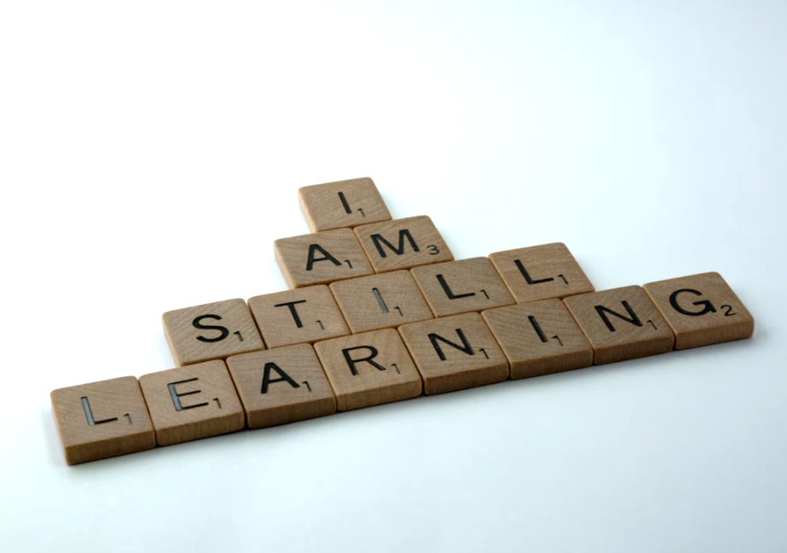
Realistic Expectations
Residency is a period of continued education and training
Development will be progressive
Trust in the program
Notes:
What does success look like?
Not “the most” or “the best”
Engagement and participation in active learning
Being open to feedback
Staying aligned to the program timeline - the appropriate pace

Slide 9
Meaningful Recognition
“It is not our responsibility to motivate others; it is our responsibility to connect the work people do each day with their passion.”
- Studer Education
Notes:
“What gets recognized, gets repeated.”
Show them that others see their value
Example: Coumadin
Be intentional in your observations
Be genuine and sincere
Be specific about what is being recognized as good work
Use every opportunity to notice good work.

Slide 10
Dear Max and kids,
I want to thank you for sharing your wife and mom with us at the clinic. Lately, she's put in a lot of long hours-including nights and weekends. I'm positive she would have rather spent those hours with you because she constantly talks about how much she loves you. Please know the work your mom does is important and helps the patients in our clinic get better. I really appreciate your mom and her quality work.
-Olivia
Source: Todd Hendricks (Studer Group)
Notes:
This example is a note that was sent by the finance director of a hospital
This note reminds the family that she loves them, that she is doing purposeful, worthwhile work, and shows appreciation for her family’s support
Element of surprise! Letter to spouse/partner/children
Hand-write the note.
Be specific and descriptive about the recognition.
Point out the good things the team member does and explain how those actions improve people's lives -- including your own.
Align the recognition to the mission and values of the organization.
Mail the note to the employee’s home address - this personalizes the thank you note; sending via mail creates a more formal recognition
Track to whom you send a note and why – this allows you to know who, and what, is being recognized on your team and see trends in performance.

Slide 11
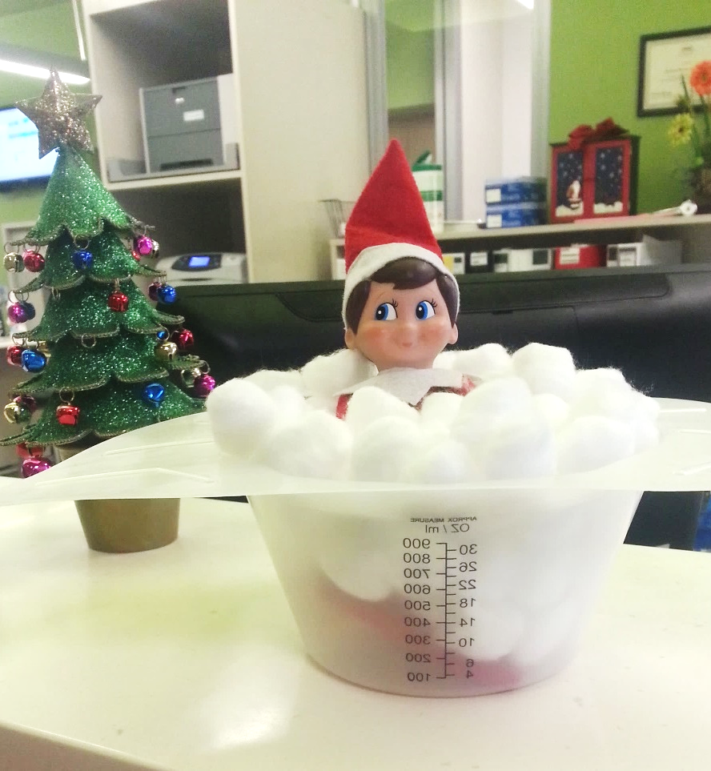
Shared Experiences
Sense of belonging
Team engagement
Notes:
Elf on the Shelf – fun and creative interaction with the next shift/ colleagues
Honey badger – mascot
Love box – taking care of each other

Slide 12
Stage 2: Working Harder
Working longer hours
Struggling with challenge stressors
high levels of workload
time pressures
responsibility
Notes:
First to arrive
Last to leave

Slide 13
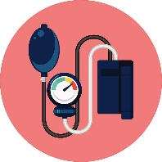
Identifying the Issue
 | Symptoms | Causes | Interventions
 | Excessive time spent charting | Lack of adequate time during scheduled workday Inefficient methods | Blocking schedule/ admin time Scribe Use of templates
 | Spending too much time in the exam room | Poor time management Not controlling the visit | Strategies for focusing patients on priority issues Shadowing efficient clinicians
 | Struggling with what to order, dosage, next steps – looking up everything | Lack of self trust in knowledge and decision making | Use of clinical resources Pocket guide Apps Pharmacist Use of templates
 | Doing things that other staff could be doing | Lack of appropriate delegation | Clarification of staff roles and duties
Notes:
Templates
- Saves time spent charting
- Saves looking up standard tests, treatments, etc.

Slide 14
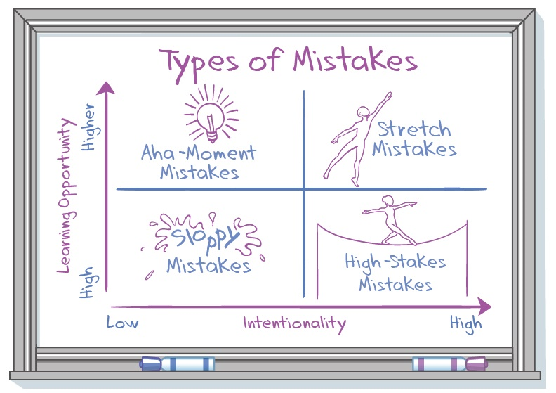
Normalize Mistakes
Talk about mistakes and teach about mistakes
Share your own mistakes and what you’ve learned
Encourage them to share with each other and analyze type and benefit
Source: Mindset Works
Notes:
Sloppy Mistakes – the least to offer
Sloppy mistakes happen when you are doing something you already know how to do. This usually happens because you are distracted.
Primarily because of carelessness
It lets you know to double check, pay closer attention or that you’re tired.
These can sometimes be turned into a-ha moments.
A-ha Mistakes – often referred to as a ‘lightbulb moment.’
These mistakes usually stem from a moment of clarity after learning something new or seeing things from a different perspective.
A-ha mistakes are when you do what you had set out to do but then realize it was a mistake to do so.
You learn what was incorrect about the result.
High Stakes Mistakes – high emotion
High-Stakes mistakes are when we mess up something very important.
We learn we need more practice, training, and knowledge so we avoid making them in the future.
Ideally, students learn bit by bit so that when the stakes are high, they can avoid mistakes.
Stretch Mistakes – the most effective mistakes
Stretch mistakes are the ones we make when acquiring a new set of skills
Stretch mistakes are mistakes you make when you are challenging yourself to learn more and are expanding your current abilities. I
t is going above and beyond what you can do without extra help.
When we make these, we want to reflect, identify what we can learn and adjust our approach to practice until we can master it.

Slide 15
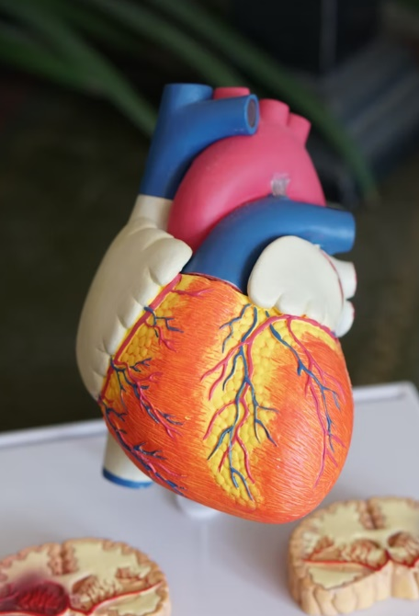
“How Could I Have Missed This?”
Notes:
Sharing mistakes is not about recounting clinical information – it is about sharing the experience from a personal perspective
I had a patient who seldom came in, and he never came in unless he absolutely had to. He arrived at his appointment very sick, and I diagnosed him with pneumonia, prescribed antibiotics, and told him to come back in one week. When he returned, he looked better. Not great, but better. I listened to his lungs – better than last week. The medication was working, and I was encouraged by his progress.
Then I listened to his heart – and I thought my own heart would stop! It was clearly abnormal. Not just “odd” but seriously, frighteningly wrong. And the week prior I had charted that his heart was normal.
While we were putting him on the EKG, I was thinking, “How could I have missed this? Did I listen for a full 60-seconds last week or was I going too fast?” I got him transferred to the hospital, and he recovered from the procedure to correct his heart rhythm.
I was so relieved when I had heard this at his follow-up visit, but I thought of little else for quite a while. I turned it over and over in my head – wondering if I should have done something differently that may have detected this issue earlier.
When I saw him again, I said, “I can’t believe I didn’t hear this on your first visit.” And get this - he thanked me for hearing it at the second visit – because it saved his life. He wasn’t angry – he was grateful- and he remains one of my most devoted patients.
It was many years later that I was reflecting on this instance and my emotional reaction. Why was I so hard on myself? Why do we default to self-blame?
It occurred to me - we do this because healthcare is built on the premise of perfection. But all this perfection makes it really hard for us to accept mistakes.

Slide 16
Stage 3: Neglecting Their Needs
Erratic sleeping
Disrupted eating
Little time for fitness and recreation
Lack of social interaction
Notes:
People experiencing burnout consistently neglect these same needs.
We are often unaware that someone is neglecting the things that are necessary for their well-being

Slide 17
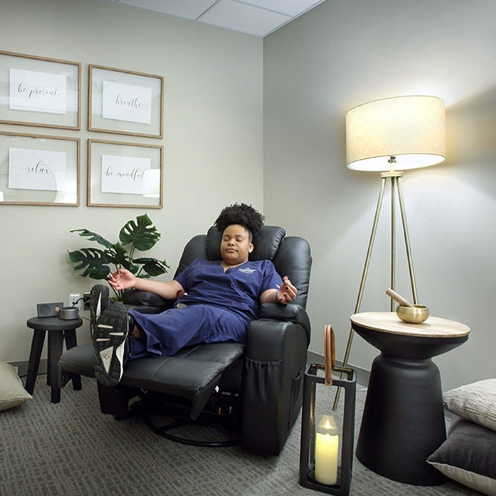
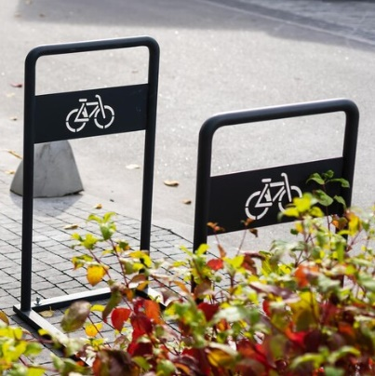
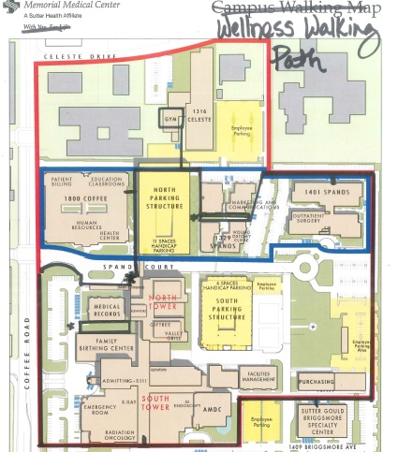
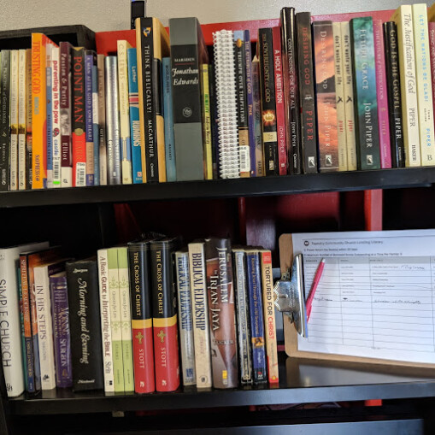
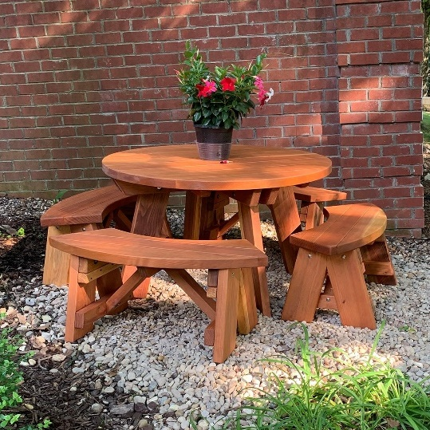
Curated Areas for Self-Care
Notes:
“Set the Stage” for self care
Offer health snacks
Set out puzzles – they are proven to boost your mood – that “satisfaction” of snapping a piece into place is due to a burst of dopamine
Map out walking paths – there are apps online that make this easy to do
Create a lending library
Install a bike rack
Add outdoor seating
Wildly successful – add a Relaxation Room or “Zen Den”

Slide 18
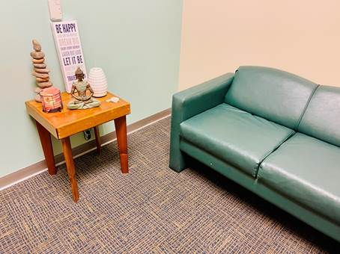
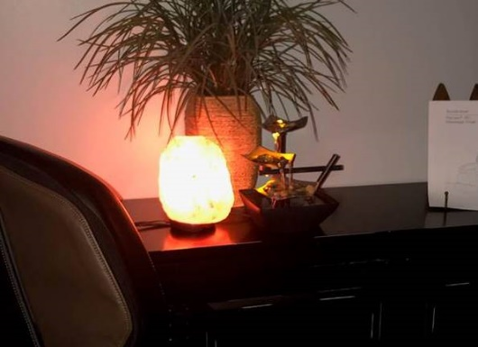
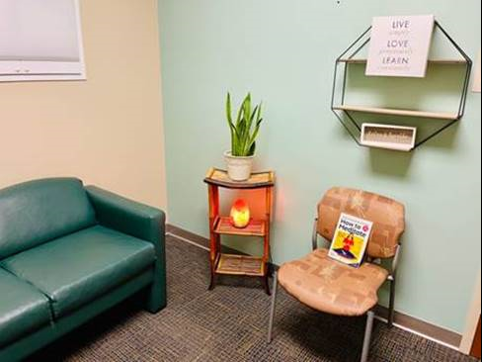
Zen Den
Designated space
Accessible location
Relief from noise
Private or semi-private
Comfortable furnishings
Item | Cost
Plant | $20
Cell phone charging station | $20
Essential oils | $20
Salt lamp | $20
Sound machine | $25
Wall décor | $100
Massage chair | $150 – 1,400
Notes:
Tranquility Room, Zen Den, Wellness Room, or something else, the benefits of a designated quiet space are based in science.
Helps to “recharge” the ability to focus
Should be a sanctuary – not a “break room” – set some guidelines for use
Not for meetings
Not for chatting
Not for playing phone games or texting
Restorative environment

Slide 19
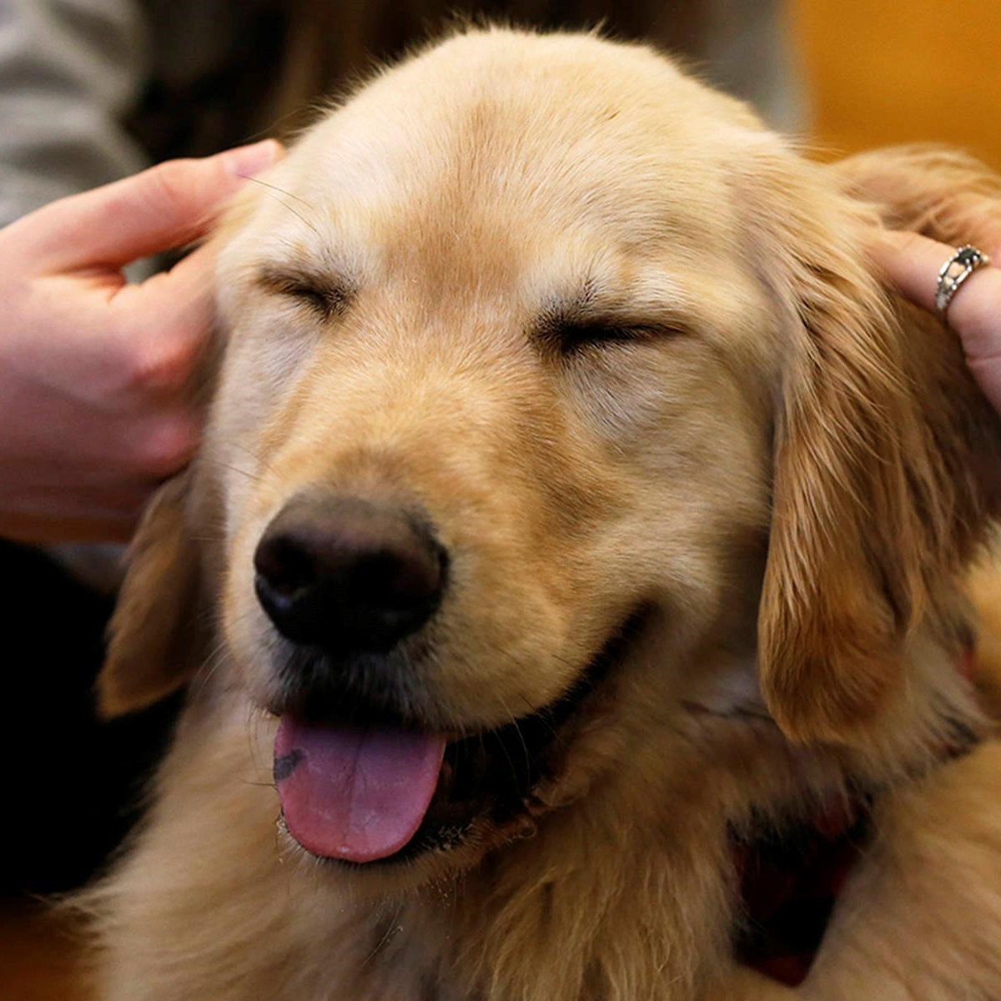
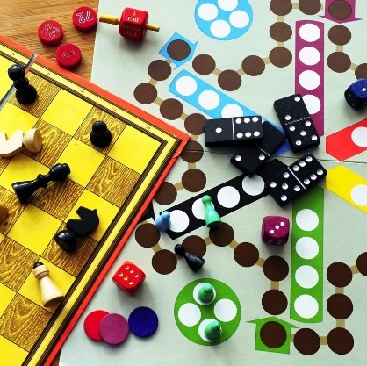
Intentional Play and Bonding
Notes:
Engaging in wellness activities in real-time
Wellness Cart
Group activities: Reading, Writing, Yoga, Meditation, Games
Designated time and space
Therapy pets

Slide 20
Dip Day
Fun tradition!
Potluck-style
Healthy dips & dippers
Free organizing apps online
Notes:
SignUp.com – free online organizer for potlucks – allows people to sign up online

Slide 21
Stage 4: Displacement of Conflicts
Avoiding their problems
Dismissing their problems
Blaming others
Feeling threatened and anxious
Notes:
You are beginning to see symptoms at this point

Slide 22
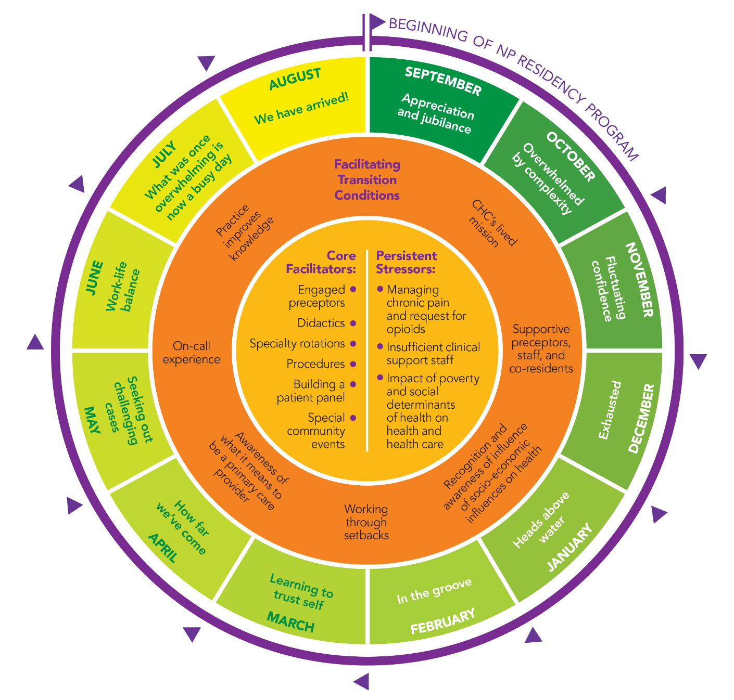
Meaningful Rounding
Open-ended questions related to where they are in their experience
“What are your thoughts on the complexity of this work?”
“What is going really well right now?”
“What are some ways you are collaborating with your colleagues?”
“When you reflect back on the past few months, what stands out most?”
Source: National Nurse Practitioner Residency & Fellowship Training Consortium
Notes:
Staff will assume you know what is broken and needs to be fixed. Asking them directly brings that information to the surface where it can easily be discussed
It can be helpful to have “visual aids” – asking residents where they see themselves in the experience
This visual is based on analysis of 1200 journal entries from 2008-2013 – NP residents
Not a “set schedule” – normal to move back and forth
Q1: Euphoria to shock and awe
Q2: Exhaustion to heads above water
Q3: From managing complexity to awareness of emerging competency
Q4: Comfort with NP role, commitment, anticipating the future

Slide 23
Addressing Emotional Intelligence
Awareness
Management
SELF
Self-Awareness Ability to accurately perceive your emotions and stay aware of them as they happen
Self Management Ability to use awareness of your emotions to stay flexible and positively direct your behavior
SOCIAL
Social Awareness Ability to accurately pick up on emotions in other people and understand what is really going on
Relationship Management Ability to use awareness of your emotions and the others’ emotions to manage interactions successfully
Source: Dr. Travis Bradberry
Notes:
Dr. Travis Bradberry – Author of Emotional Intelligence 2.0:
“Emotional intelligence is your ability to recognize and understand emotions in yourself and others, and your ability to use this awareness to manage your behavior and relationships.

Slide 24
Stage 5: Revision of Values
Consumed by work
Prioritizing work over friends and family
Physical needs, perceptions and value systems change
The job is the new value system
Notes:
values become distorted, friends and family opinions about "overwork" are dismissed, hobbies dwindle, work is only focus.

Slide 25
Be Clear and Direct
“I am worried about you” or “I’ve noticed you’ve seemed down lately.”
“Has something happened recently that you want to talk about?”
“As clinicians, we aren’t always very good at seeking help when we need it. You deserve to take care of yourself and seeking help for your own problems can help improve the care you give to your patients.”
“What would be most helpful to you right now?”
“Let’s discuss the resources we have available here, and what else you might need. How can I support you without overstepping?”
Notes:
They may think you already know how they are feeling
YOU are not their only resource
Your job is to ask questions and connect them with resources to help

Slide 26
Measuring Impact

Slide 27
Survey Instruments
Burnout - Healthcare
Maslach Burnout Inventory – Human Services Survey (MBI-HSS) for Medical Personnel
Burnout – Any Occupational Group
Oldenburg Burnout Inventory
Single Item Burnout Measure (embedded in the Mini-Z)
Copenhagen Burnout Inventory
Composite Well-Being
Stanford Professional Fulfillment Index
Well-Being Index (WBI)
Notes:
Many options available
Can also use informal assessments

Slide 28
QUESTIONS

Slide 29
THANK YOU
Surani Hayre-Kwan, DNP, MBA, FNP-BC, FACHE, FAANP
SuraniHL@sonic.net
SHayreKwan@samuelmerritt.edu
Surani.Hayre-Kwan@sutterhealth.org

Slide 30
APPENDIX

Slide 31
Quick Reference
Stage | What it looks like | What causes it | What managers can do
Stage 1: Proving their worth | Enthusiasm, taking on a lot of responsibility, “above and beyond” | Feeling unaccepted; lack of confidence; feeling of unworthiness; hindrance demands (role conflict, role overload, and role ambiguity) | Clarify expectations – in training Emphasize the progressive stages of the program Include inclusion in shared experiences and traditions Give meaningful recognition
Stage 2: Working harder | Overtime, longer hours, “burning the midnight oil” | Inefficiencies; Challenge stressors (high levels of workload, time pressures, and responsibility) | Identify the cause – offer tools and strategies to address
Stage 3: Neglecting their needs | Fatigue, difficult to engage; “living off of caffeine” | Not sleeping or eating well; Lack of social interaction | Create experiences that benefit the team “Set the stage” for individuals Organize active wellness activities Foster social connection
Stage 4: Displacement of conflicts | Jittery, defensive; “not my fault” | Feeling anxious or threatened | Meaningful rounding Coach on communication skills and awareness (self and others)
Stage 5: Revision of values | Hobbies dwindle, personal relationships suffer; “doubling-down” on work efforts | Feeling spread too thin; Belief that sacrificing self-care and relationships is necessary for self-preservation | Voice concern Offer support

Slide 32
Stages of Burnout 6-12
Stage | Stage | Description
6 | Denial of Emerging Problems | Cynical approach with some aggressive or intolerant behaviors Consider colleagues or clients or patients as stupid, demanding or uncooperative Problems may be blamed on time pressure and “all the work I have to do”
7 | Withdrawal | Person’s social life begins to feel small or nonexistent. They seek relief in seclusion or embrace escapism through alcohol or drugs. Minimal social contact turns into isolation
8 | Odd Behavioral Changes | Co-workers, family, friends and others in their immediate social circles can’t overlook the behavioral changes taking place.
9 | Depersonalization | Person fails to see themselves or others as valuable; this is accompanied by a failure to acknowledge themselves or others’ needs. Person starts to view no one and nothing as having any value, extreme cynicism, no longer even acknowledge or see one's own needs
10 | Inner Emptiness | Lonely and extreme sign of impending burnout, defined by a feeling of numbness or “emptiness,” which some may seek to overcome with binge activities like overeating, drug or alcohol abuse, shopping, gambling, online gaming, etc.
11 | Depression | Person feels lost and unsure, exhausted, with a bleak worldview, and no enthusiasm for the future.
12 | Burnout Syndrome | Can include total mental and physical collapse, prolonged sick leave, career disintegration possible In extreme cases suicide may occur, with it being viewed as an escape from their situation. At this stage, seek medical attention.

Slide 33
References
Klein, C. J., Weinzimmer, L. G., Cooling, M., Lizer, S., Pierce, L., & Dalstrom, M. (2020). Exploring burnout and job stressors among advanced practice providers. Nursing Outlook, 68(2), 145–154. https://doi.org/10.1016/j.outlook.2019.09.005
Team meeting tool: The 12 phases of burnout. (2020, April 28). DVM 360. https://www.dvm360.com/view/team-meeting-tool-12-phases-burnout
Bradberry, T. (2022). Emotional Intelligence 2.0 Hardcover – June 16, 2009 by Travis Bradberry. TalentSmart; Har/Dol En edition (June 16, 2009).
Valid and Reliable Survey Instruments to Measure Burnout, Well-Being, and Other Work-Related Dimensions. (2022, May 18). National Academy of Medicine. https://nam.edu/valid-reliable-survey-instruments-measure-burnout-well-work-related-dimensions/

Slide 34
Post-Web Cafe Survey:
https://chc1.iad1.qualtrics.com/jfe/form/SV_aXJSq8GtGQwpw46
SAVE THE DATE:
December 7, 2022 at 3:00pm (EST) Web Café:
“Remediation and Fostering a Collaborative Learning Environment”
Notes:
.

