Slide 1
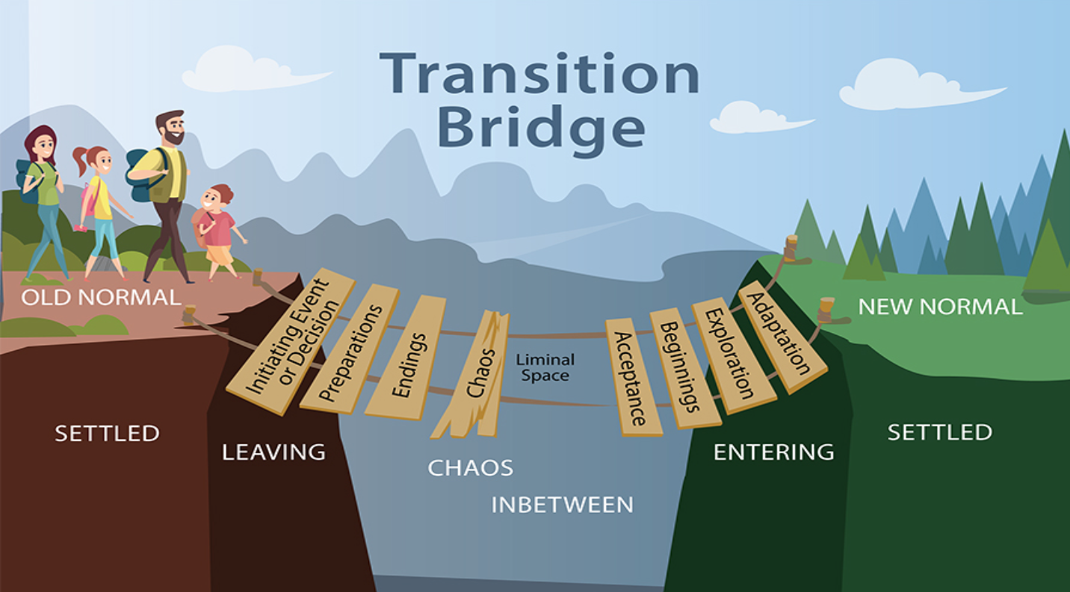
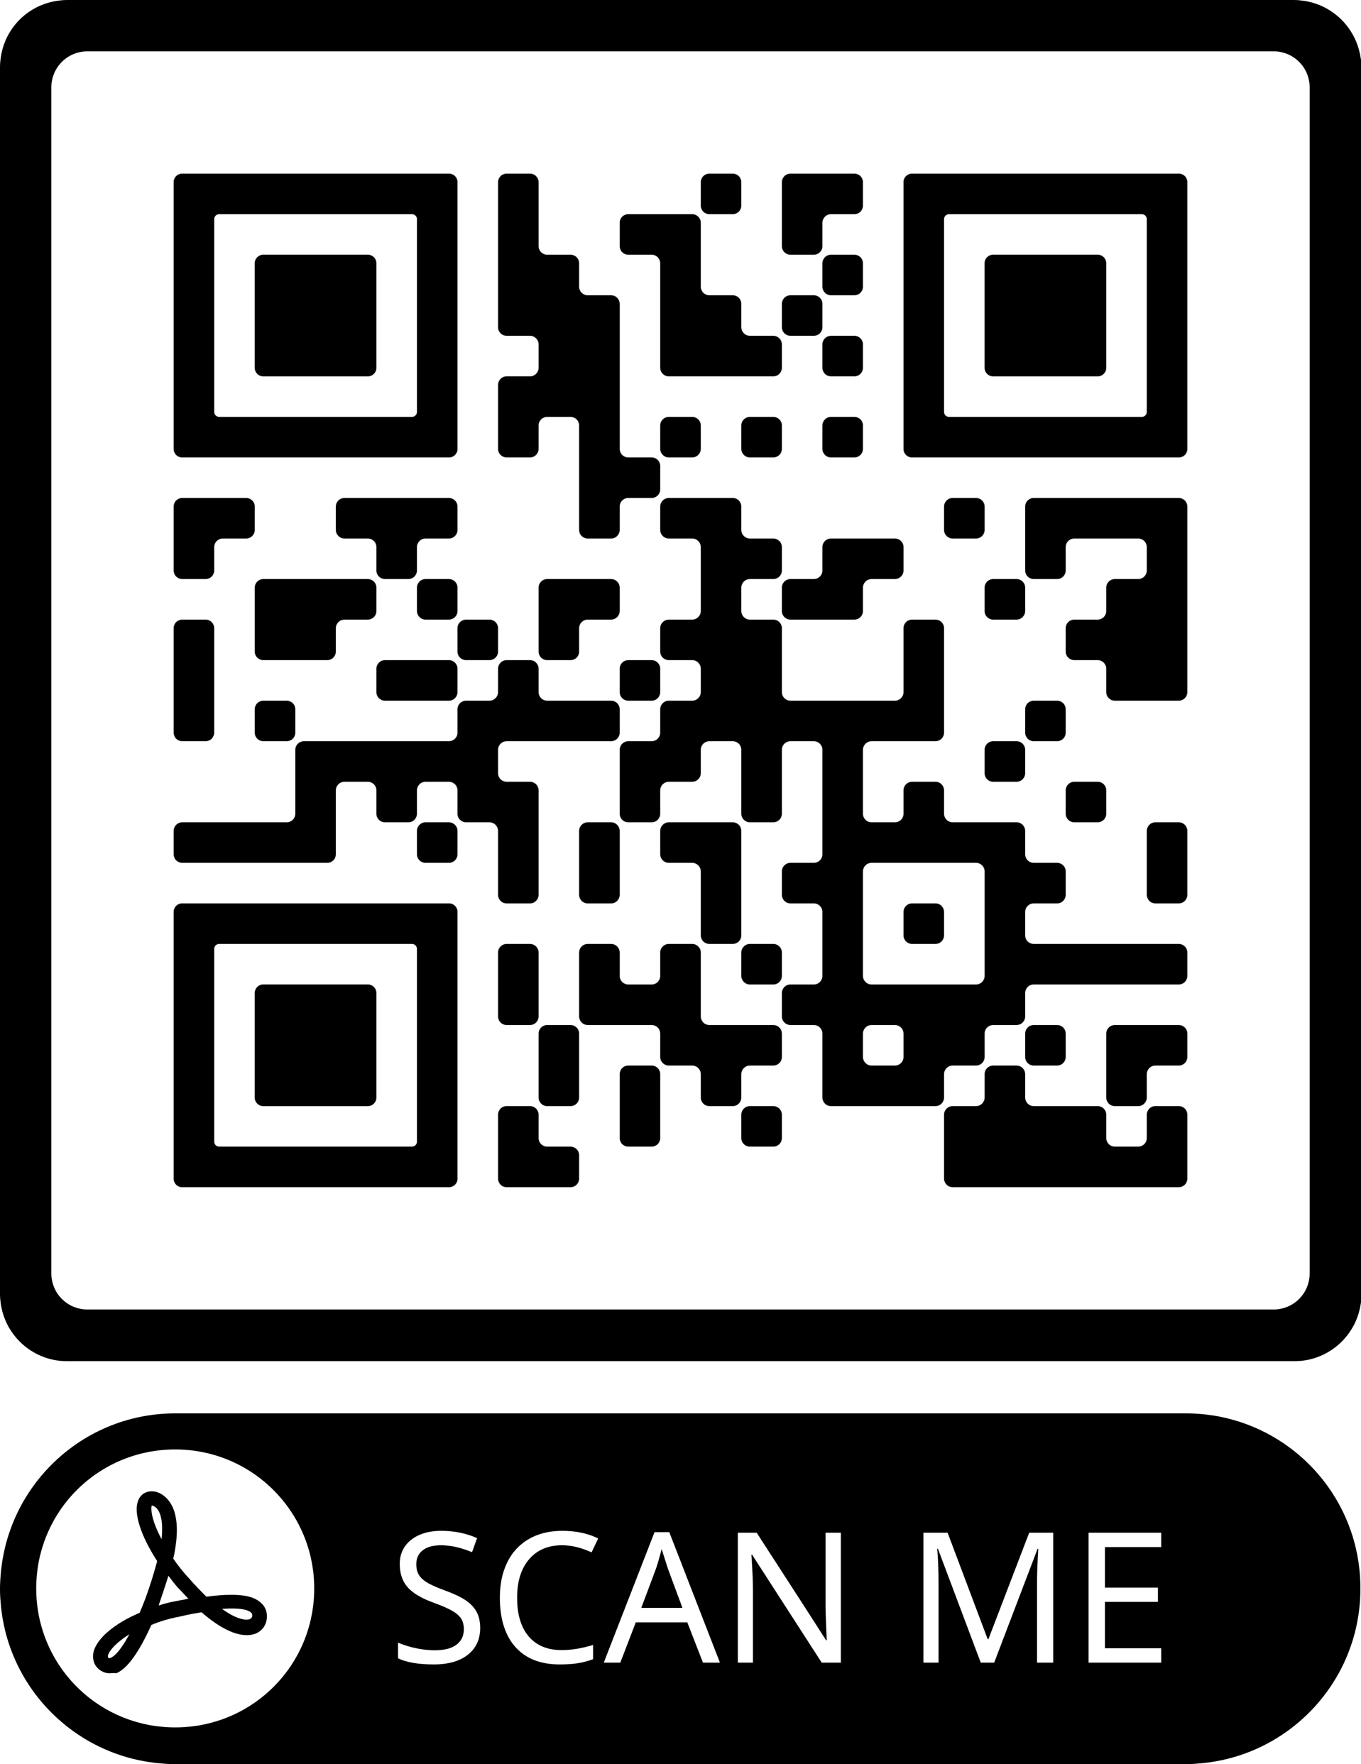
Evaluating an Advanced Practice Nurse (APRN)
Residency Program via UDS Measures
Olivia Sitton, DNP, BS, BSN, AGPCNP-BC, RN, CMSRN
Background
Methods
Discussion
Problem 1:
36,000+ NPs graduated in 2020 and would benefit from a formal transition process from RN to provider role (American Association of Nurse Practitioners, 2021)
APRN residency programs are being developed and need feedback
Problem 2:
Provider capture rates of Uniform Data System (UDS) measures are down
Connection:
UDS measures are quantifiable to evaluate provider/resident performance
Significance of UDS Measures
Standardized reporting system for Federally Qualified Health Centers (FQHC) developed by the HRSA that qualifies center for federal funding
Reflects the impact of health centers on patients/communities via preventative screening and disease management
Evidence Synthesis
Residencies offer heightened awareness & increase confidence, knowledge, & provider satisfaction scores (Brooks & Fulton, 2020;)
Strengths/Facilitators
The APRN residency program director was curious about a QI project to evaluate the program’s effectiveness via UDS measures
UDS measures are reported annually so the Informatics team is experienced with this information
Limitations/Barriers
Data mining; Determining the most appropriate data for this project
Limited information
Growing program with a small number of residents
Missing national UDS averages for 2021
Institutional Review Board: ASU & Federally Qualified Health Center (FQHC) Research Committee approvals
Setting: FQHC in the Southwestern United States
Population: All providers at the FQHC (n~300); All past and present APRN residents (n=18)
Intervention: Data extraction and review capture of UDS measures in the EMR from 2019-2021
Data Collection: UDS data was extracted by the FQHC’s Chief Quality/Medical Informatics Officer and Team from the software analysis program Relevant
Data Analysis: Statistical tests via Intellectus using two-tailed, one sample z-tests
Conclusions
(Train International, 2019)
Summary
Residents do significantly better capturing UDS measures compared to non-resident providers
Implications
APRN Residency Programs offer training and support that promotes best practices like capturing UDS measures that reflects quality care for patients
Future Recommendations
Continue to trend UDS measure capture
Identify barriers to capturing UDS measures
Results
Table 1:
Statistical Significance for mean UDS capture rate of residents (M) versus all other non-resident providers at the FQHC (μ) from 2019-2021 with p < .001
Note. The symbol * indicates a measure in which the mean (μ) of non-resident providers at the FQHC performed better than the residents for that year.
Statistically significant (stat. sig.) p<.001:
Residents performed better on 7 out of the 10 stat. sig. measures compared to the non-resident providers at the FQHC (90 total z-tests)
Residents performed better on all 19 stat. sig. measures compared to national data (45 total z-tests)
Cohort | Measure | Year | Resident Mean (SD) | FQHC Mean (μ)
1 | Colorectal Screening Ages 5-75 | 2019 | 45.57 (10.05) | 65.8*
1 | Depression Screening and Follow Up Ages 12+ | 2019 | 91.07 (2.74) | 82.1
1 | HIV Screen Ages 16-66 | 2021 | 89.25 (0.49) | 80.9
1 | Mammogram Ages 50-74 | 2019 | 54.33 (2.25) | 67.2*
1 | Weight & F/U Plan Ages 18+ | 2020 | 79.23 (3.23) | 67.4
2 | HIV Screen Ages 16-66 | 2020 | 86.27 (5.30) | 78.1
2 | HIV Screen Ages 16-66 | 2021 | 88.89 (3.94) | 80.9
2 | Weight & F/U Plan Ages 18+ | 2020 | 76.96 (5.46) | 67.4
2 | Weight, Diet & Activity Ages <16 | 2021 | 72.94 (1.99) | 75.5*
3 | Weight & F/U Plan Ages 18+ | 2021 | 79.08 (8.95) | 66.1
Project Purpose
Acknowledgement and References
To evaluate an APRN Residency Program for effectiveness and quality improvement (QI) via UDS measures
To identify if APRN resident satisfaction (measured in another project) impacts UDS measures
Thank you, Dr. Moffett for all your time and
continued guidance throughout this journey
Contact Information: ossitton@asu.edu

