Slide 1
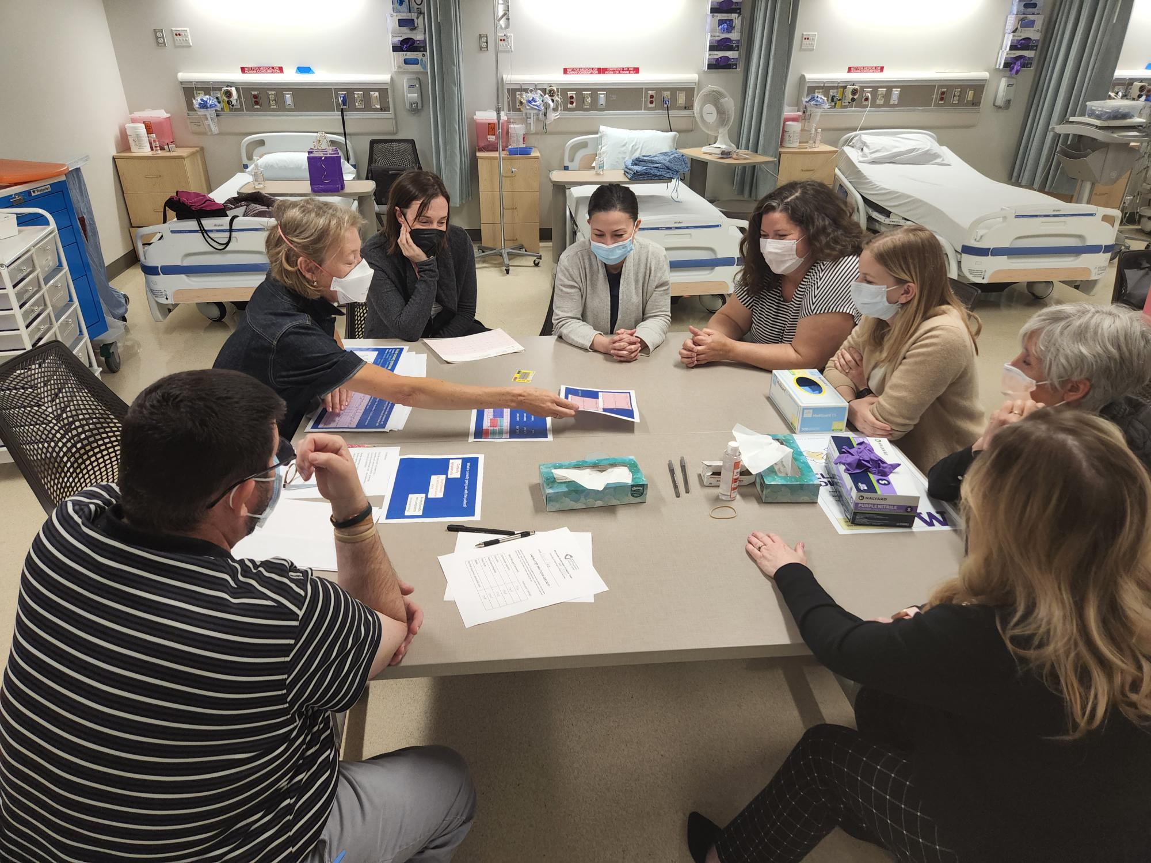
Year 1: Fellowship Reflections From An Academic Partner
Anita M. Souza, PhD^{1.,} Rebecca Wood, MSW¹; Heather Novak DNP, ARNP, FNP-BC²; Ron Oman ARNP, FNP-BC³; Katha Gazda ARNP, FNP-BC³; Dave Little, MD²; Anne Hirsch, PhD, ARNP¹
¹ University of Washington; ² Valley View Health Center ; ³Harbor Regional Health
Purpose
Results
In 2020, the University of Washington, School of Nursing (UW-SoN) launched the Premera Rural Nursing Health Initiative. The UW-SoN serves as the coordinating center providing infrastructure, support, and guidance to the two inaugural fellowship sites: Valley View Health Center (VVHC) and Harbor Regional Health (HRH). Each site enrolled two Family Nurse Practitioners in the Fellowship program.
Findings resulted in the identification of five key themes that contributed to success and support in the first year of fellowship implementation with the University of Washington as the academic partner.
Research comprised the support and role of the coordinating center in designing and implementing research and evaluation of sites.
Examples: Development of key evaluation tools, organization and implementation of evaluation protocol
Logistics centered as a key theme for activities related to daily operations that supported and freed up sites to focus on daily engagement with fellows.
Example: Weekly didactics were arranged and developed by UW in collaboration with sites.
Institutional Access highlights the importance of academic resources made available to fellowship sites.
Examples: Fellows and Site faculty were given access to remote library services including up-to-date
Two intensive skills labs were held at the UW-SoN’s simulation lab.
Network Collaboration was a theme that captured all aspects of support that came from consultation and provider networks engaged by the UW-SoN.
Examples: well-being session, faculty development workshops, specialty rotations
Financial support is also centered as a key theme supporting multiple aspects of the fellowship.
Example: $20,000 per fellow financial support to the clinical site, Computers, Travel Support
Methods
UW-SoN team in partnership with VVHC and HRH program directors utilized a reflective journaling approach to capture lessons learned in Year 1. Thematic analysis was employed to analyze the findings. Thematic congruence was validated through member checking across UW-SoN, VVHC, and HRH.
Impact
The UW as an academic coordinating center has provided important infrastructure that supports rural sites in the development and implementation of Fellowship programs.
Funded through the generosity of the Premera Foundation.
Learn more
Learn more!

