Slide 1
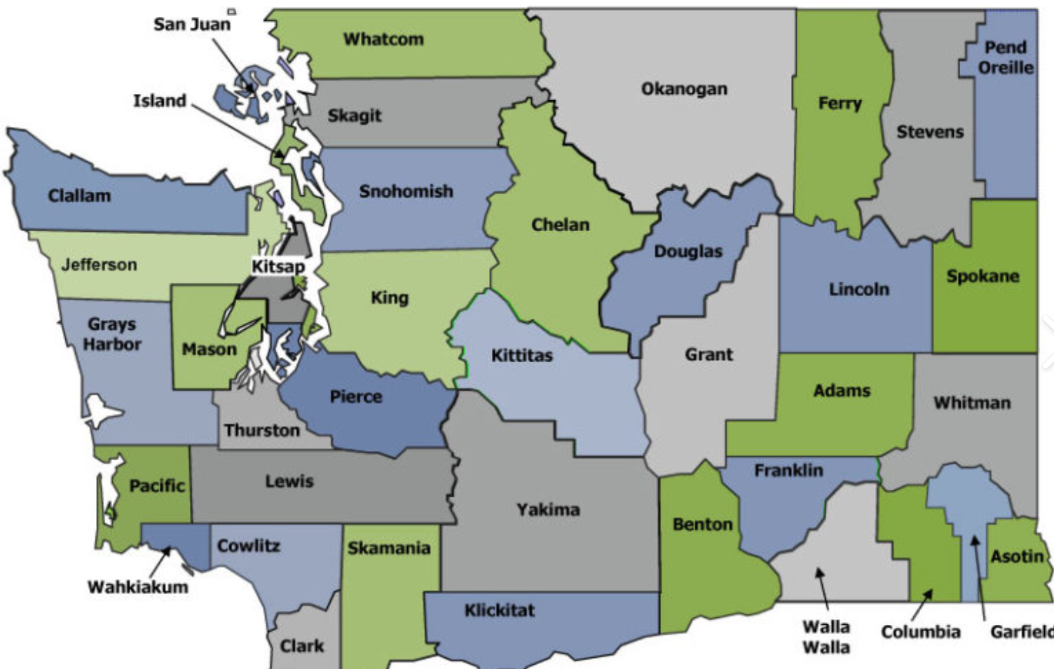
Year 1: Fellowship Reflections From Program Directors
Heather Novak, DNP, ARNP, FNP-BC¹, Anita M. Souza, PhD^{2.,} Rebecca Wood, MSW²; Anne Hirsch, PhD, ARNP, FAANP, FAAN²;
¹Valley View Health Center ; ²University of Washington
Purpose
Results
In 2020, the University of Washington, School of Nursing (UW-SoN) launched the Premera Rural Nursing Health Initiative. One of the goals of this initiative is to partner with rural primary care clinics to support recently graduated ARNPs in their transition to practice through the development and implementation of a year-long fellowship program. Valley View Health Center (VVHC), a Federally Qualified Health Center (FQHC) located in southwestern Washington State, entered into the partnership as one of two sites in the first year. VVHC is a collection of smaller clinics spread across three counties that provides Medical, Dental, Behavioral Health, and Pharmacy services. Two Family Nurse Practitioners were enrolled in the Year 1 cohort at VVHC.
Four distinct themes emerged from the analysis of the data. The themes of Organizational Vision, Faculty Leadership, Pearls for Faculty and Fellows, and Academic Partnership represent critical areas of insight from VVHC leadership and the UW-SoN in this first year of a rural-focused fellowship program.
Organizational Vision is related to statements regarding overall organizational support and preparedness to engage in a fellowship commitment.
“Communication with staff about the program is essential. If they understand the purpose and goal of the Fellowship, it helps them educate patients”
Faculty Leadership identified key needs for program directors and clinical preceptors that serve as fellowship faculty.
“Define the role of Program Director and have administrative time dedicated to support multifaceted needs.”
Pearls for Faculty and Fellows is comprised of insights into key logistical and workflow considerations.
“Provide a shared Calendar which all Fellows and Preceptors have access too. This allows for better tracking of who is responsible for the Fellows on which days.”
Academic Partnership highlighted collaborative supports that were instrumental in laying the foundation for an evidence-based fellowship.
“Allowed us to have a cohort experience with other rural clinics. This allowed for sharing and engaged us in a wider and more robust network to share the challenges and successes of fellowship development.”
Impact
The foundational insights learned in year 1 of the rural fellowship programs are important to quality improvement efforts to ensure a robust fellowship program that supports new nurse practitioners in developing clinical confidence and skills to meet the challenges of the rural health environment.
Methods
The Fellowship Program Director of VVHC and the UW-SoN team used a reflective journaling approach to capture lessons learned in Year 1. Thematic analysis was utilized to analyze the findings. Thematic congruence was validated through member checking.
Funded through the generosity of the Premera Foundation.
Learn more!

