Slide 1
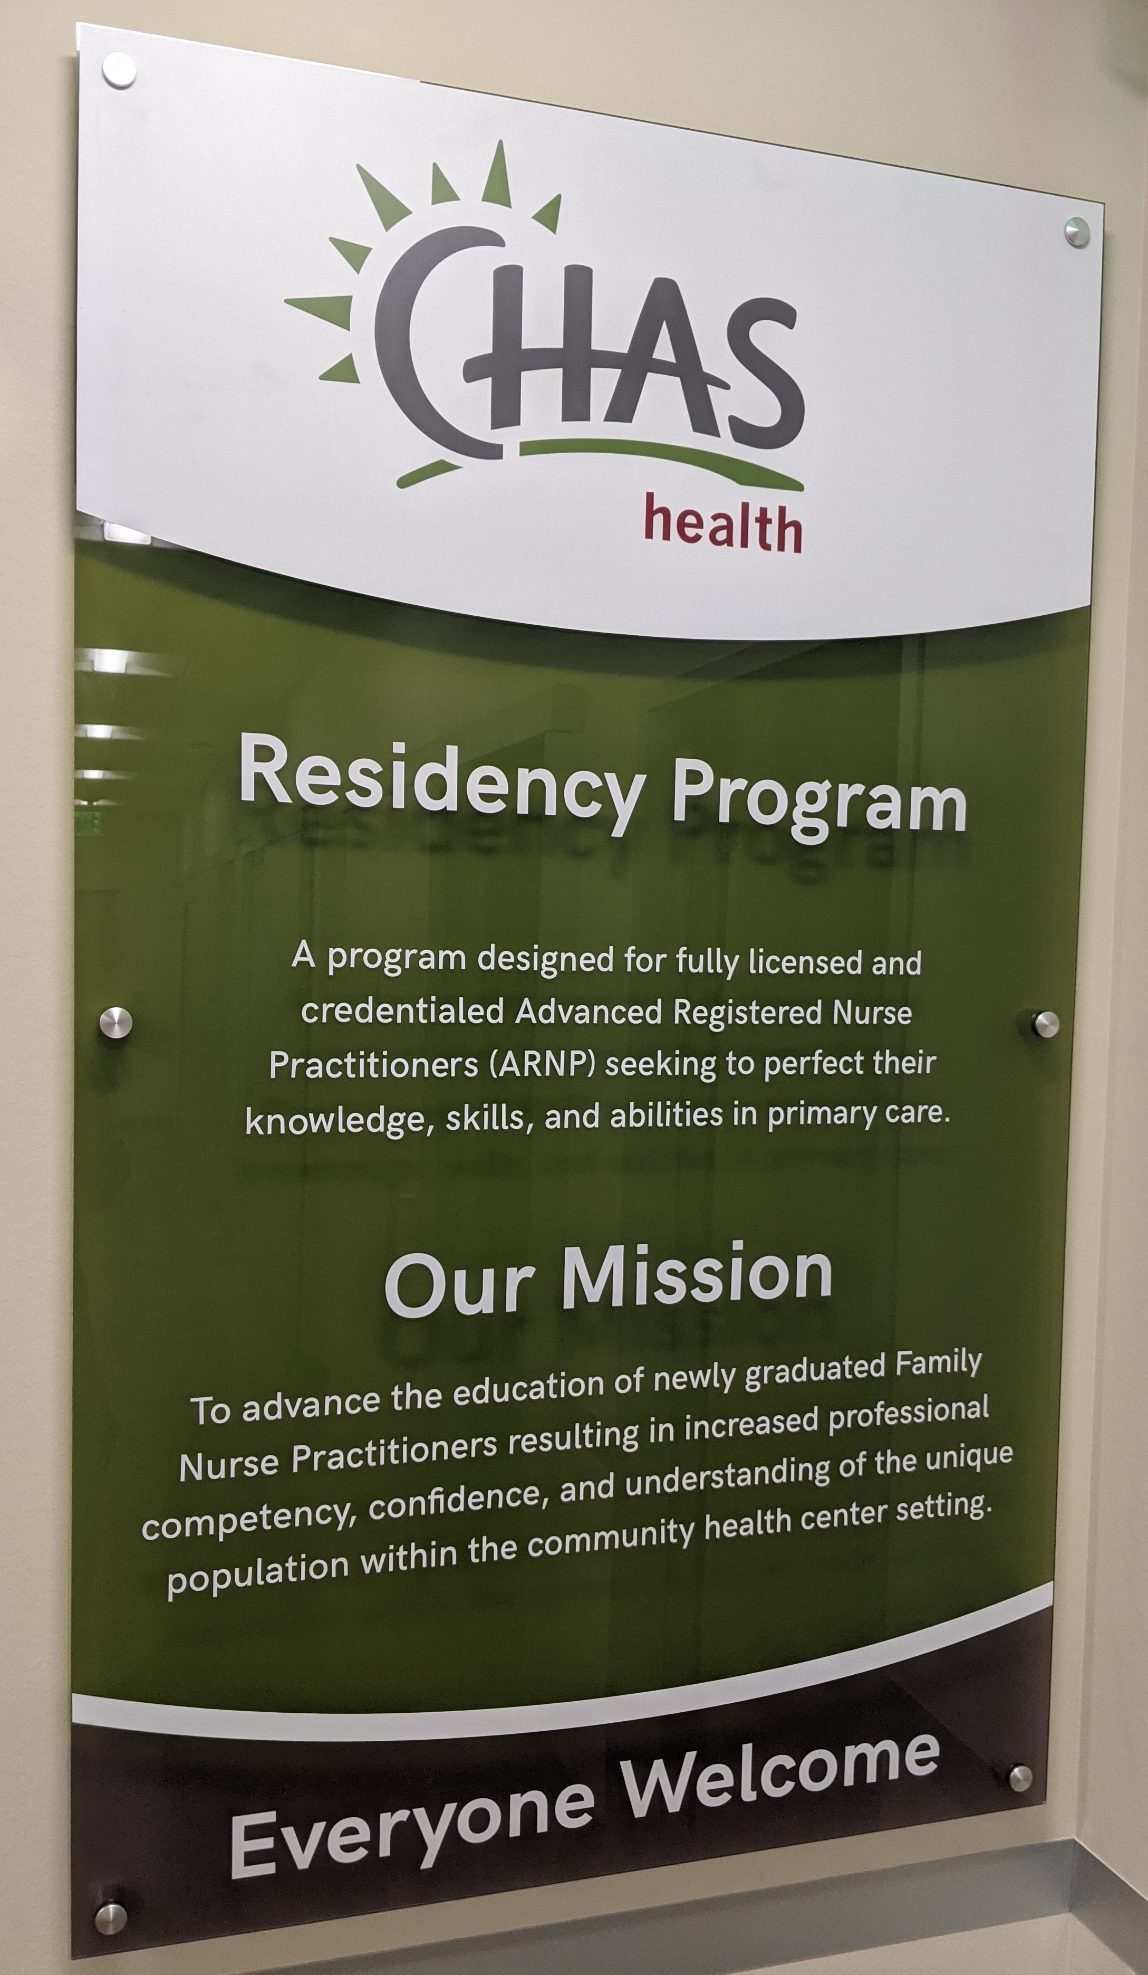
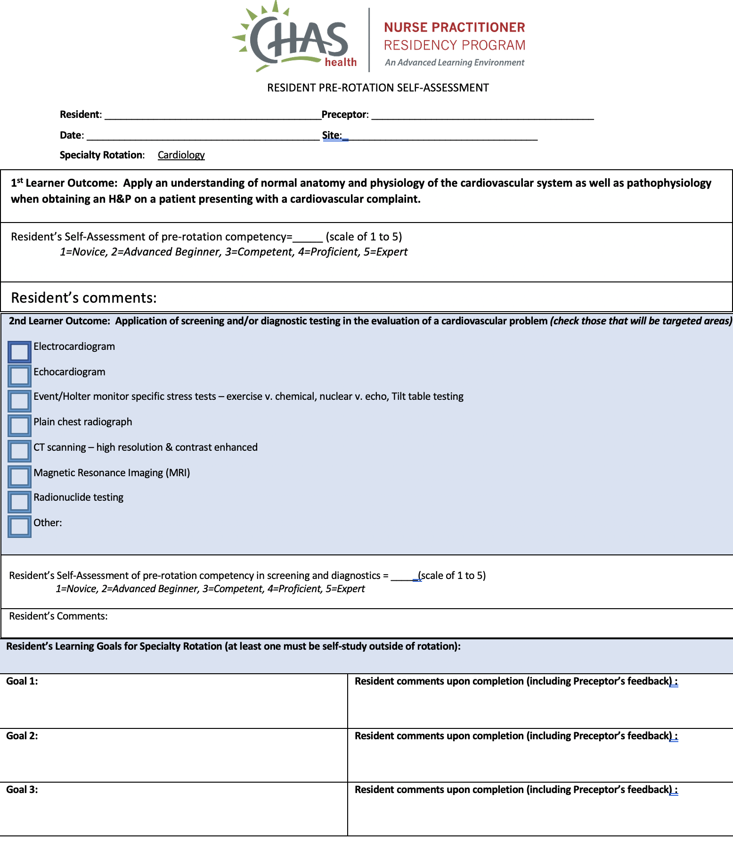
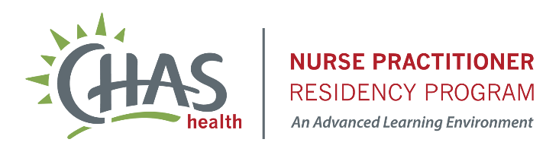
Implementing and Evaluating a Pre-Post Rotation Self-Assessment to Improve Nurse Practitioner Residency Program Specialty Rotations
Todd Smith MSN, ARNP , Marian Wilson, PhD, RN; Fionnuala Brown, DNP, ARNP; Janet Purath, PhD, RN; Brandie Tilch-Bryant, DNP, ARNP
Project purpose
The purpose of this project was to identify nurse practitioner residents’ individual needs for specialty rotation experiences and implement targeted goal-setting to help with knowledge acquisition necessary for practice in a Federally Qualified Health Clinic.
NEEDS Assessment
Identified that the core specialty rotations in a Nurse Practitioner residency program did not target individual learner needs or goals
Results
Pre-rotation: 6 residents completed 26 self-assessments in the eight specialty rotations
Post-rotation: 14 of the 26 self-assessments were returned
Competency Rating
Pre-rotation self-selected learning objectives
  Mean 2.3, Range 1-4
  Mode 2 (43.5% of responses)
  Indicates “Advanced beginners”
Post-rotation of self-selected learning objectives
  Mean 2.9, Range 2-4
  Mode 3 (71.4% of responses)
  Indicates “Competent”
Common Themes Identified
Gaining skills
“Goal met. We saw so many COPD and asthma patients. I learned a lot about inhalers and tons of pearls in COPD and asthma management.”
Experiencing growth
”The biggest areas of improvement include interpretation of US, MRI, CT, and microscopy. I really want more exposure to all of the diagnostic tests listed above but will focus on my weakest areas.”
Identifying learning needs
“Would love to learn more about detecting abuse. Think I am able to recognize overt abuse but can certainly learn more and would like to learn about local resources.”
Method
A pre- and post-rotation self-assessment was developed to assess residents' knowledge and skills in providing care in specialty areas
Residents rated their competency in specialty skills before and after each rotation using a Likert-style scale where 1=novice and 5=expert (REFERENCE)
Open-ended items asked residents to state their goals of the specialty rotation and comments on progress made towards learning goals
Data were analyzed using descriptive statistics and open-ended items were explored for common themes using content analysis
Impact
A methodical approach to prepare for specialty rotations can assist nurse practitioner residents in identifying and targeting their individualized learning needs. Further innovations can seek to improve post-rotation self-assessment completion scores and validate the usefulness of numeric data

